Slide 1
Payment and Delivery System Reform in Medicare
Alliance for Health Reform
April 11, 2016
Cristina Boccuti, MA, MPP
Associate Director, Program on Medicare Policy
Kaiser Family Foundation

Slide 2
Payment and Delivery System Reform in Medicare: Context
ACA included several provisions to initiate payment and delivery system reforms in traditional Medicare, including:
  Hospital payment adjustments based on performance measures
  The Medicare-Medicaid Coordination Office
  The Medicare Shared Savings Program
  The “Innovation Center” or Center for Medicare & Medicaid Innovation (CMMI)
    With authority to expand models that either lower spending without reducing the quality of care, or improve the quality of care without increasing spending
Medicare Access and CHIP Reauthorization Act (MACRA) reforms Medicare payments for physician services
  Beginning in 2019, physicians participating in alternative payment models (APMs) will receive increased fee-schedule payments; APMs to be defined in regulation
New HHS goal: shift an increasing portion of traditional Medicare payments from volume- to value-based reimbursement, up to 90% by 2018

Slide 3
Selected Models: Medical Homes, ACOs, and Bundled Payment
Delivery System Reform | CMS/CMMI Models
Medical Homes (Advanced Primary Care) | Multi-Payer Advanced Primary Care Practice (MAPCP) Comprehensive Primary Care (CPC) Initiative Federally-Qualified Health Center (FQHC) Advanced Primary Care Practice Independence at Home
Accountable Care Organizations (ACOs) | Medicare Shared Savings Program (MSSP) Pioneer ACO Advance Payment ACO (subset of MSSP)
Bundled Payment | Bundled Payment for Care Improvement (BPCI) Models 1-4 Model 1: Inpatient hospital services Model 2: Inpatient hospital, physician, post-acute services Model 3: Post-acute services Model 4: Inpatient hospital, physician services

Slide 4
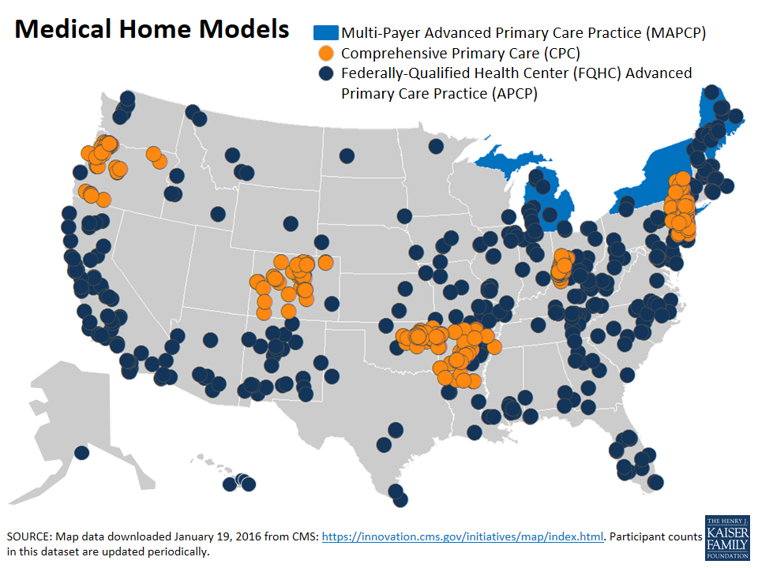
Medical Homes
Concept: Focus on providing and coordinating care from within primary care practices in team-based approach; care management fees paid by insurers
  Multi-Payer Advanced Primary Care Practice (MAPCP)
    5 states; 1,200 medical homes; 900,000 beneficiaries
    $4.2 million in net savings; quality results to come (2011-2012)
  Comprehensive Primary Care (CPC) Initiative
    4 states and 3 regions; 445 practices; >410,000 Medicare & Medicaid beneficiaries
    Savings have not fully offset fees; decreased hospital admissions and ED use (2014)
    Federally-Qualified Health Center (FQHC) Advanced Primary Care Practice (APCP)
    >400 participating sites; 200,000 Medicare beneficiaries
    No savings or quality improvements relative to comparison FQHC (end of 2013)

Slide 5
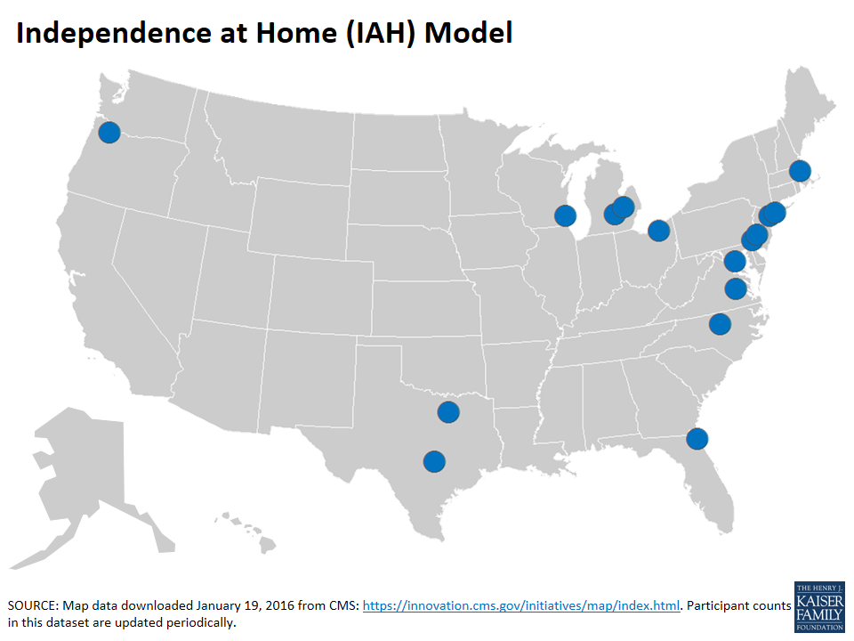
Independence at Home
Concept: Medical practices provide chronically-ill beneficiaries with home-based primary care; no care management fee, but providers can share in savings
15 participating practices serving 8,400 beneficiaries
Patients must be living with multiple chronic conditions,
had a hospitalization within past year, and require assistance with ADLs
$25 million in savings in first year; all practices met quality goals on at least 3 of 6 measures; model extended through 2017

Slide 6
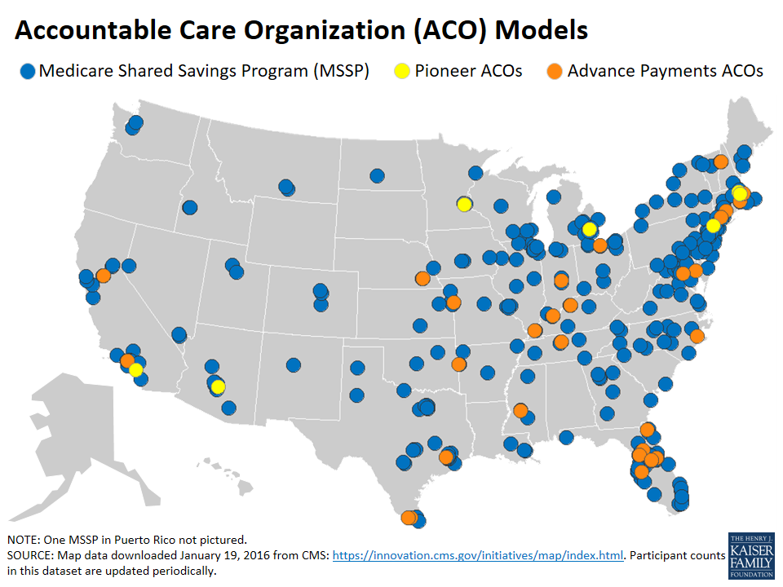
Accountable Care
Organizations (ACOs)
Concept: Groups of providers collectively accept responsibility for overall spending and quality outcomes for attributed beneficiaries; opportunities to share in savings/losses
~450 MSSP and Pioneer ACOs serving ~8 million beneficiaries
  Reported same or better quality than traditional Medicare
  MSSP ACOs
    >90% of ACO beneficiaries
    Vast majority in one-sided risk “track”
    ~25% received shared savings; among them, net savings totaled $465 million; excludes MSSPs that did not produce savings (2014)
  Pioneer ACOs
    9 participants
    Required financial risk
    ~50% received shared savings payments; net Medicare savings: $47 million (2014)
    CMMI has authority to expand

Slide 7
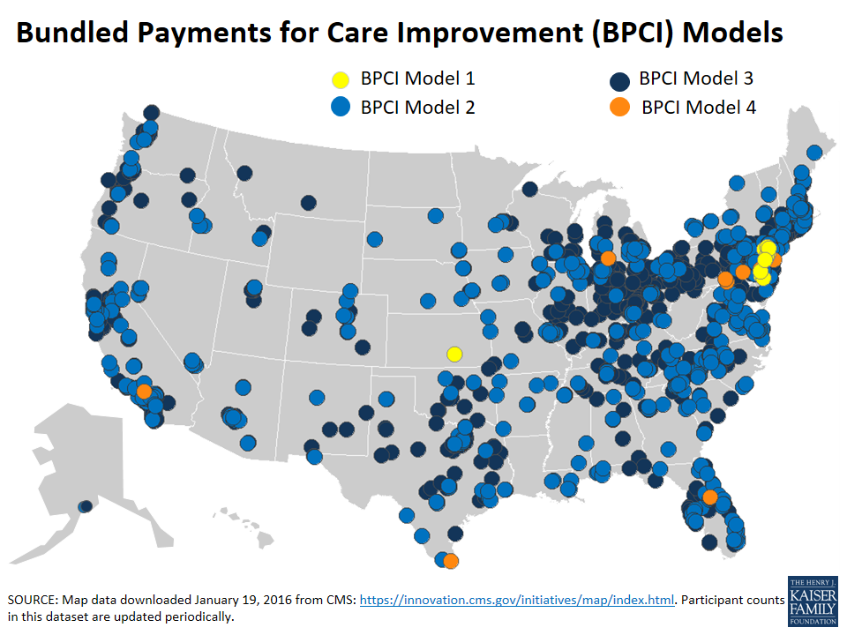
Bundled Payment Models
Concept: Establish a total budget for all services provided to a patient for an episode of care (starting with a hospitalization), rather than individual provider/setting payments; providers can share in savings if episodes are below budget
6,000+ participants in four BPCI models serving 130,000 Medicare beneficiaries
Model 1: lower cost growth during hospital stays, but not post-discharge; models 2-4: results based on small samples and limited timeframe (2013-2014)
Focus of services for each BPCI model
Model 1: | Inpatient hospital services
Model 2: | Inpatient hospital, physician, post-acute services
Model 3: | Post-acute services
Model 4: | Inpatient hospital, physician services

Slide 8
Ongoing challenges and opportunities
CMS has launched many new payment and delivery system models in a fairly short period of time, and in a changing health care environment.
Further evaluation results on all models are expected; evaluations can take time.
Ability to refine models during implementation presents both opportunities and challenges.
Ultimately, a key consideration for CMS and Congress is how Medicare beneficiaries fare in these new models, especially those with the greatest health care needs.

Slide 9

Medicare Resources on kff.org
Exhibit 13
Payment and Delivery System Reform in Medicare: A Primer on Medical Homes, Accountable Care Organizations, and Bundled Payments Aiming for Fewer Hospital U-turns: The Medicare Hospital Readmission Reduction Program A Primer on Medicare: Key Facts About the Medicare Program and the People it Covers Income and Assets of Medicare Beneficiaries, 2013 – 2030
For more information,
visit kff.org/medicare

