Slide 1

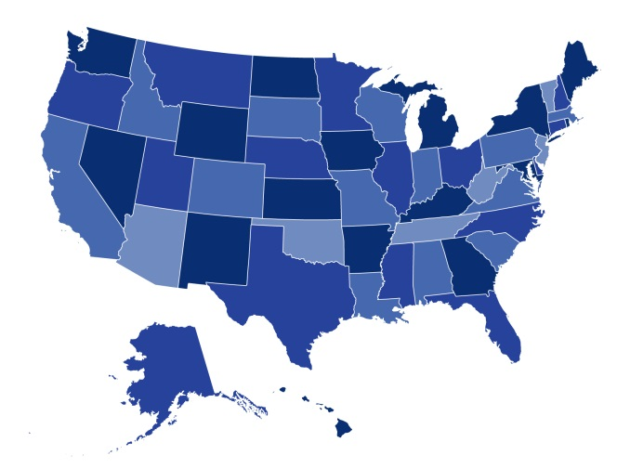
Alliance For Health Care Reform
Trends in Coverage and Affordability on the ACA Marketplaces
July 15, 2016
Kevin Lucia, M.H.P., J.D.
Research Professor
Georgetown University

Slide 2

Overview
Insurer Participation in the Marketplaces
Beyond UnitedHealthcare in 2017
  Federal Considerations and Ongoing Concerns

Slide 3
Insurer Participation in the Marketplaces
In 2016, insurer participation in the marketplace remained relative stable
  Nine SBMs experienced no net change, while three saw a net gain and five realized a decline
  HHS reported a similar trend in the FFM
  Analysis shows more stability than news coverage would suggest
Moving into 2017…
  Despite recent announcements of insurer departures, including United and multiple CO-OPs, we need to look broadly at participation trends relating to new entrants, expanded service areas, and local competition
Could insurer participation rules stimulate increased competition?
  Many SBMs have used insurer participation rules as a lever for driving competition; some indications of success

Slide 4
Looking Beyond UnitedHealthcare: Varying Perspectives Exist
While UnitedHealthcare is one of the nation’s largest insurers, it’s important to consider its role in the marketplaces
  Was slow to enter the marketplaces and expanded rapidly
  Has not always played a major role in driving competition
  Maintains a modest share of marketplace enrollment
A balanced analysis requires a broader perspective of marketplace stability
  Looked to the largest, publicly traded insurers participating in the marketplaces and reviewed first quarter earnings calls and financial statements
  Realized other experiences and perspectives on the marketplace exist

Slide 5
Beyond UnitedHealthcare: What are other, large, publicly traded insurers telling investors?
Insurers are not withdrawing from the marketplaces en masse
  There appears to be along term committed to the marketplaces
  For example, Anthem noted continued participation in 14 marketplaces and the potential for future expansion
Marketplace enrollment remains stable, growing for some
  Most insurers experienced recent membership growth
  For example, Aetna reported enrollment above expectations, with a gain of about 200,000, while Molina experienced the largest total membership increase — 420,000 — in the company’s history

Slide 6
Beyond UnitedHealthcare: What are other, large, publicly traded insurers telling investors?
Risk pools continue to evolve, but some are experiencing a healthier mix than others
  While evidence suggests, unsurprisingly, that marketplace consumers have been sicker, on average, than enrollees in the nongroup market, the risk experiences of insurers have varied
  For example, Molina commented that its marketplace enrollees have been comparatively healthy, while Centene noted that its risk mix remains consistent with expectations
Insurers continue to view the marketplaces as offering unique business opportunities
  For example, most insurers continue to assert that the marketplaces offer value and claim they are, for example, “well positioned” (Anthem) or in a “very good place” (Anthem) to grow and sustain this line of business

Slide 7
Recent Federal Responses Have Attempted to Address Ongoing Concerns
Insurers flagged perceived challenges to their marketplace business, such as changes to the ACA’s risk-adjustment program and tightening eligibility standards for special enrollment periods
Indications that federal regulators are listening to insurer concerns, such as offering changes to SEP rules, restricting the sale of short-term durational policies and considering adjustments to the risk adjustment methodology

Slide 8
Looking Forward
Insurance industry doesn’t have a monolithic perspective on the marketplaces
  There are clearly insurers that see a business value in marketplace participation
Not all insurers will thrive in this new and developing market
  Some will not be able to compete in an environment where consumer protection rules reward effective risk management and prohibit discriminatory practices
Federal and state policymakers need to look for opportunities to:
  Stabilize and diversify risk pools, improve local market competition, encourage insurers to compete on product quality rather than premium alone, and promote effective risk management

Slide 9

Thank you!
Kevin Lucia, M.H.P., J.D.
Research Professor
(202) 687-4928
kwl@georgetown.edu

