Slide 1

State of our Children’s
Health, Care and Coverage
Alliance for Health Reform
April 4, 2011
Mary Mason, M.D., MBA, FACP
Chief Medical Officer and Senior Vice President,
Centene Corporation

Slide 2
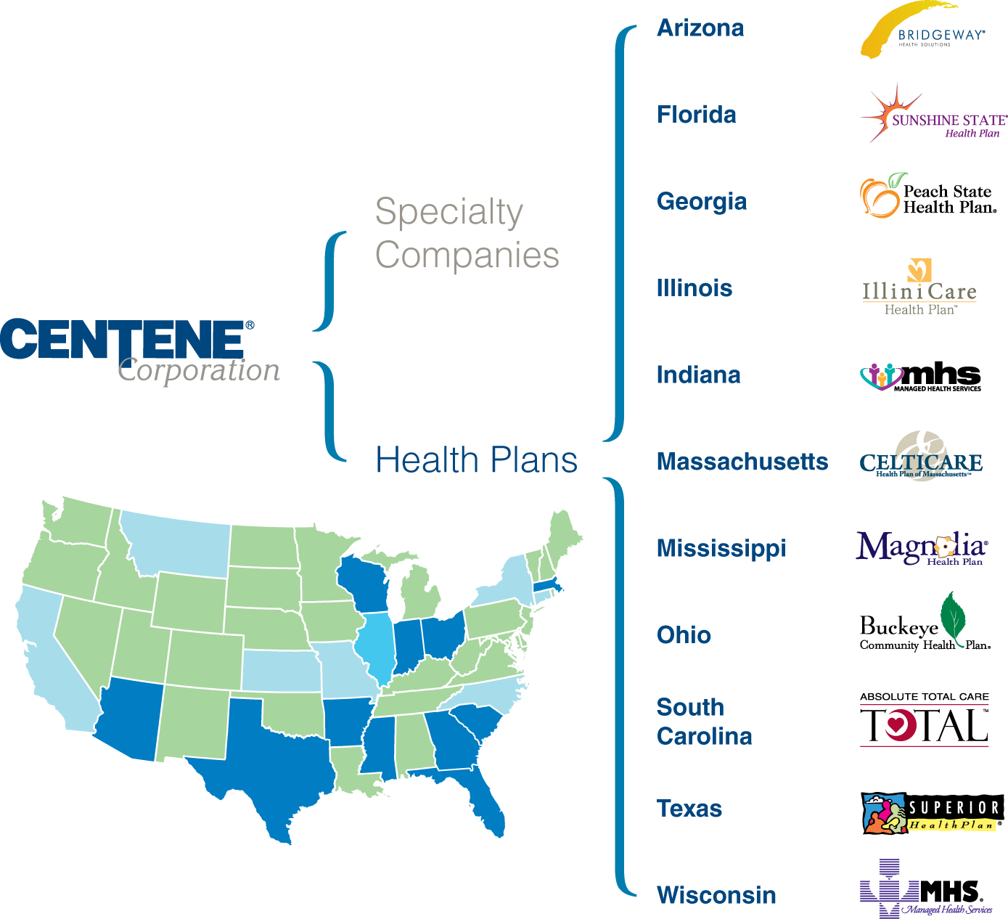
Centene Corporation
Provides health plans, programs and related services
  Coordinated care of government sponsored programs
  Medicaid, TANF, SSI, SCHIP, foster care, special needs plans
  Health plan services offered in 12 states with multiple product lines
  Contracts with 81,000 physicians, 950 hospitals and 255 Federally Qualified Health Centers (FQHCs)
  Seven health management companies

Slide 3
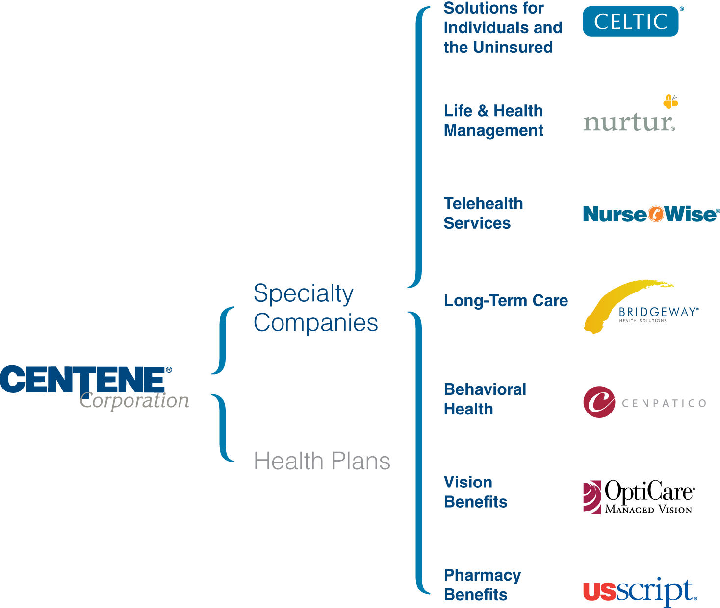
Integrated Solution
Single integrated solution for delivering care between health plans and ancillary services that generate healthier outcomes

Slide 4
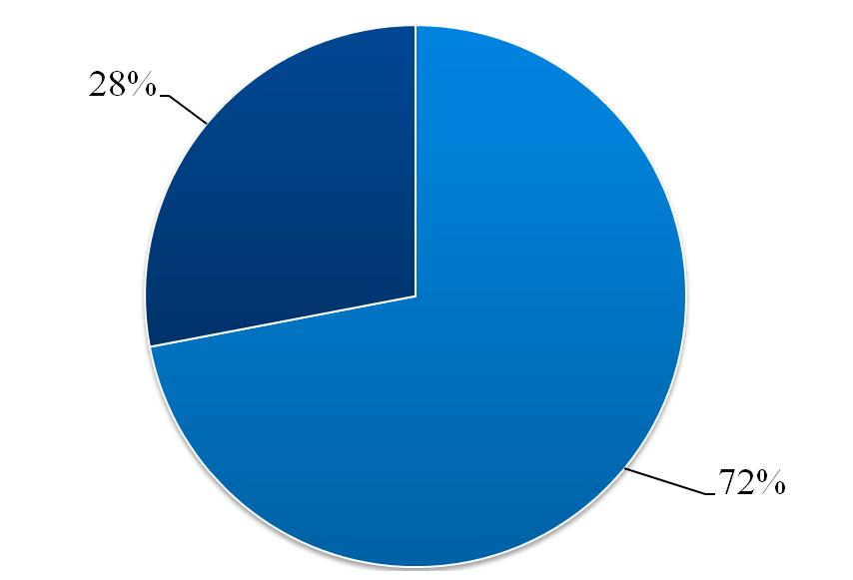
Our Members
1.5 million members
  Children
  Women who are pregnant
  Adults
  Foster care
  Long-term care programs
72% of our members are 18 years old or younger
18+
Years old
0-18
Years old

Slide 5
Our Goals
Focusing on improving
health outcomes
  Ensure members get the care they need in the most appropriate setting
    Increase primary care visits
    Reduce unnecessary Emergency Room visits
  Link members to a Medical Home
  Increase EPSDT screenings, prenatal / postpartum care and HEDIS rates
  Be good stewards of state and taxpayer resources by providing high quality, cost effective care
Centene will provide better healthcare outcomes at lower costs by coordinating appropriate care in the right setting

Slide 6




Significant Health Issues Face our Members
Obesity
Respiratory Ailments
Prenatal and Postpartum Care
Lack of health and wellness education

Slide 7
Obesity Trends Among U.S. Adults
BRFSS, 1990, 2009
(*BMI ≥30, or about 30 lbs. overweight for 5’4” person)
1990
2009
No Data <10% 10%–14% 15%–19% 20%–24% 25%–29% ≥30%
The Facts
  Obese children are at high risk of contracting additional chronic illnesses such as heart disease, high blood pressure, asthma, cancer and diabetes

Slide 8




Fighting Childhood Obesity
Centene Approach
  Educational efforts (specialized books)
  School visits
  Provider incentives
  Customized patient interventions

Slide 9
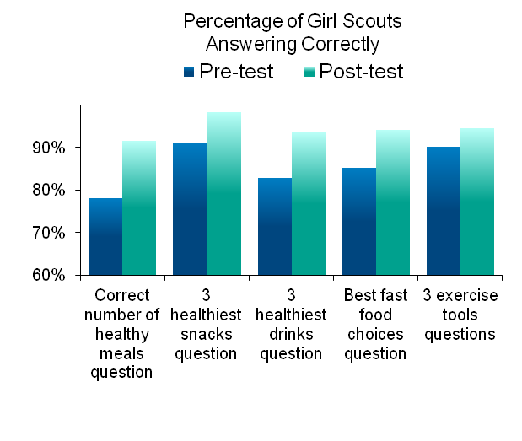


Fighting Childhood Obesity
Partnership with the Girl Scouts
  Targeted 200 Brownie troops in Missouri & Georgia
    Attend schools where the number of students receiving free- or reduced lunch exceeds 50%
  Brownies completed several tasks to earn a badge
  Outcomes show increased understanding of nutritional topics

Slide 10
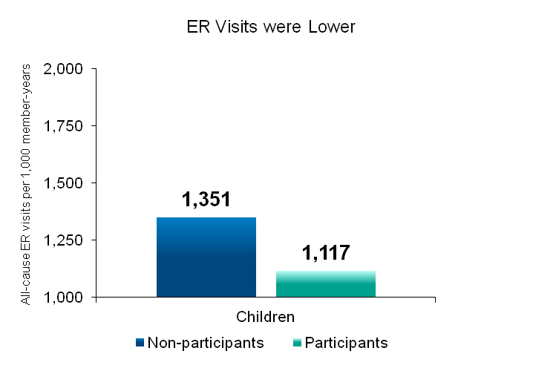
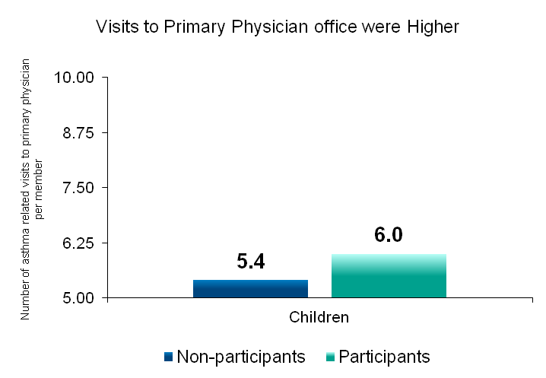
Combating Asthma in Children
Indiana members enrolled in a disease management program for individuals with asthma
  Outcomes showed improvement to number of ER visits and visits to their PCP
17.3% difference
11.1% difference

Slide 11



Combating Asthma in Children
Centene also created an educational campaign targeting children with Asthma
2010 Silver Medalist:
National Health Information Awards

Slide 12
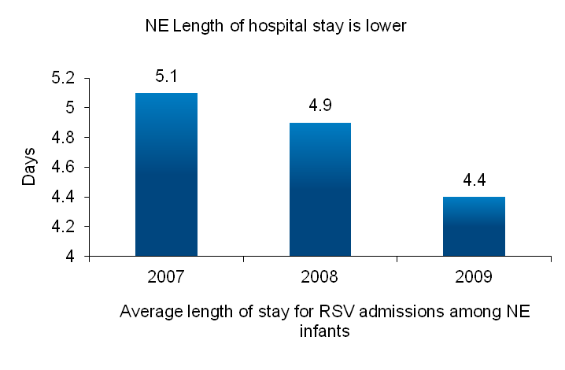
Centene’s RSV Prevention and Management Program
Respiratory Syncytial Virus (RSV) is a major source of respiratory illness in children
  Certain high risk infants can develop severe illness and respiratory failure
Centene’s RSV prevention and management program focuses on:
  Education
  Identification
  Responsible utilization of immunoprophylaxis (Palivizumab)
Result:
  Average length of hospital stay is lower
  96% compliance with multiple dose therapy
  Our program helped save $8 million in 2010

Slide 13



Start Smart for Your Baby®
We manage the health care for more than 60,000 pregnant members each year
Centene’s comprehensive pregnancy management program
  Wellness and Disease Management
  Case Management
  Care Coordination
Extends from pre-conception to the first 1-2 years of life of the child
URAC Best Practice Platinum Winner
URAC/GKEN Best Practice Winner

Slide 14


Start Smart for Your Baby®
Several educational books and tools supplement case management
Recent collaboration with the American Academy of Pediatrics to develop, “Start Smart, A Guide to Your Baby’s Care – The First Year”
Award winning efforts
  Audio book- Gold medal - Web Health Award
  Pregnancy book- Silver medal - Health Information Award
Pregnancy book endorsed by The March of Dimes

Slide 15
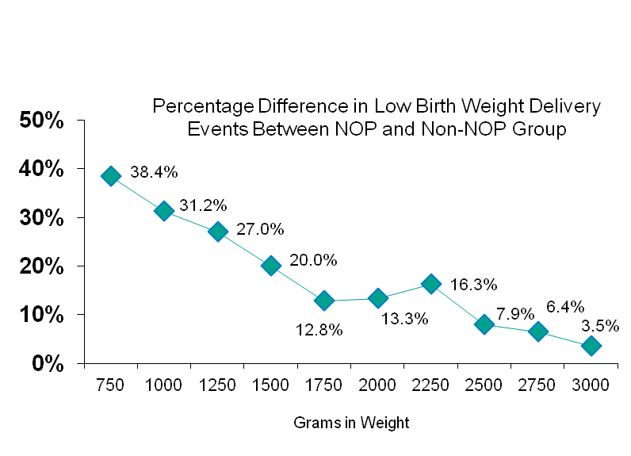
Start Smart for Your Baby®
Early identification is key
    Notification of Pregnancy form (NOP) helps determine the risk of the pregnancy
    Customized predictive modeling software helps identify pregnancies
Extremely Low-birth weight:
Under 1000g
31.2% fewer with use of an NOP
Very Low-birth weight:
Under 1500g
20% fewer with use of an NOP
Low-birth
weight:
Under 2500g
7.9% fewer with use of an NOP
Article to be published in April 2011 Managed Care Magazine

Slide 16
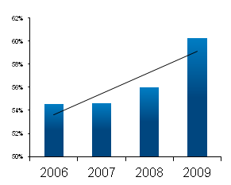
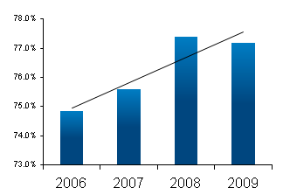
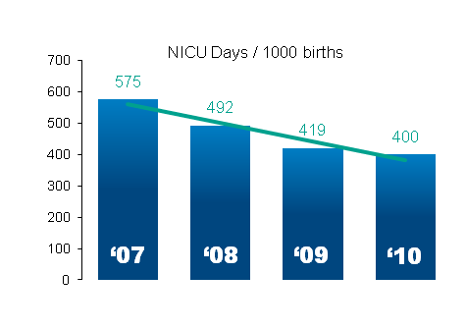
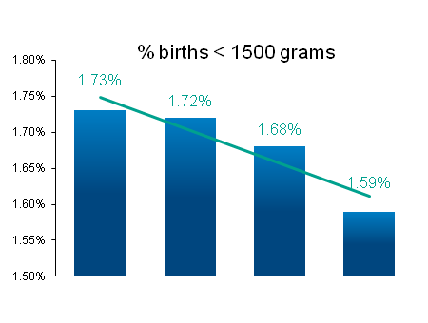
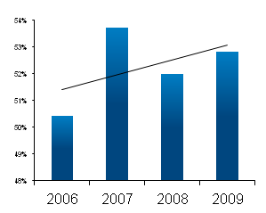
Start Smart for Your Baby®
Frequency of Physician Visits
Start Smart shows improvement in several measurements of care, including birth outcomes
Start Smart for Your Baby costs approximately $75 per pregnancy, but saved $14 million in 2010 due to lower neonatal intensive care unit costs.
Timeliness of prenatal care
# of Days in the NICU is Dropping
# of Low Birth Weight Deliveries is Decreasing
Timeliness of postpartum care
‘07
‘08
‘09
‘10

Slide 17
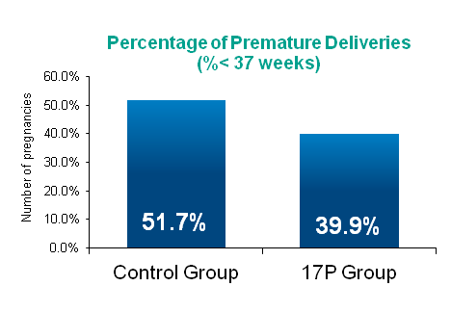
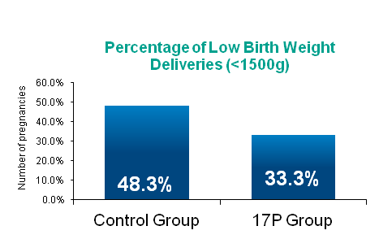
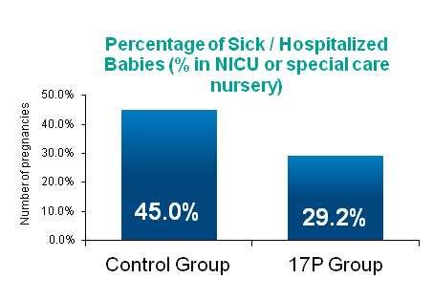
Pre-term Pregnancy: 17P
Centene has been a pioneer in the use of 17P in the effort to reduce pre-term deliveries
  Annual U.S. societal economic burden estimated at $64,000 per pre-term infant
We have proprietary, customized reporting methods to identify high-risk pregnancies
For those women who initiate treatment with 17P, results show:
  Reduction in the rate of recurrent preterm deliveries
  Reduction the rate of low birth weight deliveries
  Lower rate of NICU admissions
Article published in February 2010 Managed Care Magazine

Slide 18

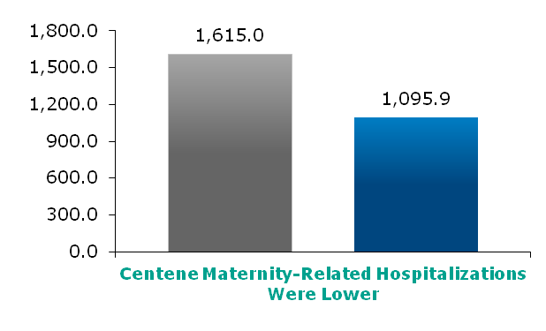
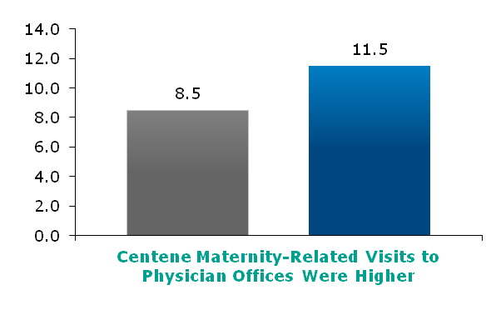
Pregnancy and Smoking
Centene’s Response:
Puff Free PregnancyTM Program
  Based on clinical guidelines published by The American Congress of Obstetricians and Gynecologists and the U.S. Public Health Service
Health coaches help design individual cessation plans
Self reported quit rate 29.6%
  Benchmark is 13.3%
Result: There are fewer maternity related hospitalizations, while visits to physician offices is higher
Non
Participant
Participant
Non
Participant
Participant

Slide 19


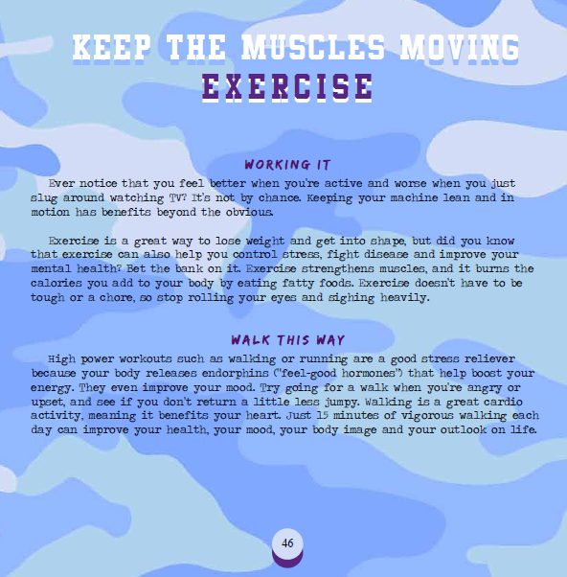
Wellness Education for Children and Teens
Centene’s teen book, “Off the Chain,” addresses a host of issues facing pre-teens and teens
  Designed to help foster care children
  Addresses hygiene, domestic violence, jobs, finances, bullying, and more
Non
Participant
Participant
Non
Participant
Participant

Slide 20

Achieving Results for Children
We have a wide range of efforts underway to help the health and care of children
  Obesity
  Respiratory Ailments
  Prenatal and Postpartum Care
  Wellness
We are continuing to explore new ways to help them during the vulnerable times of their lives

Slide 21
Contact Information
Mary Mason, MD, MBA, FACP
Chief Medical Officer & Senior Vice President
Centene Corporation
(202) 223-8010
www.centene.com

