Slide 1
Patrick Conway
Centers for Medicare and Medicaid Services

Slide 2
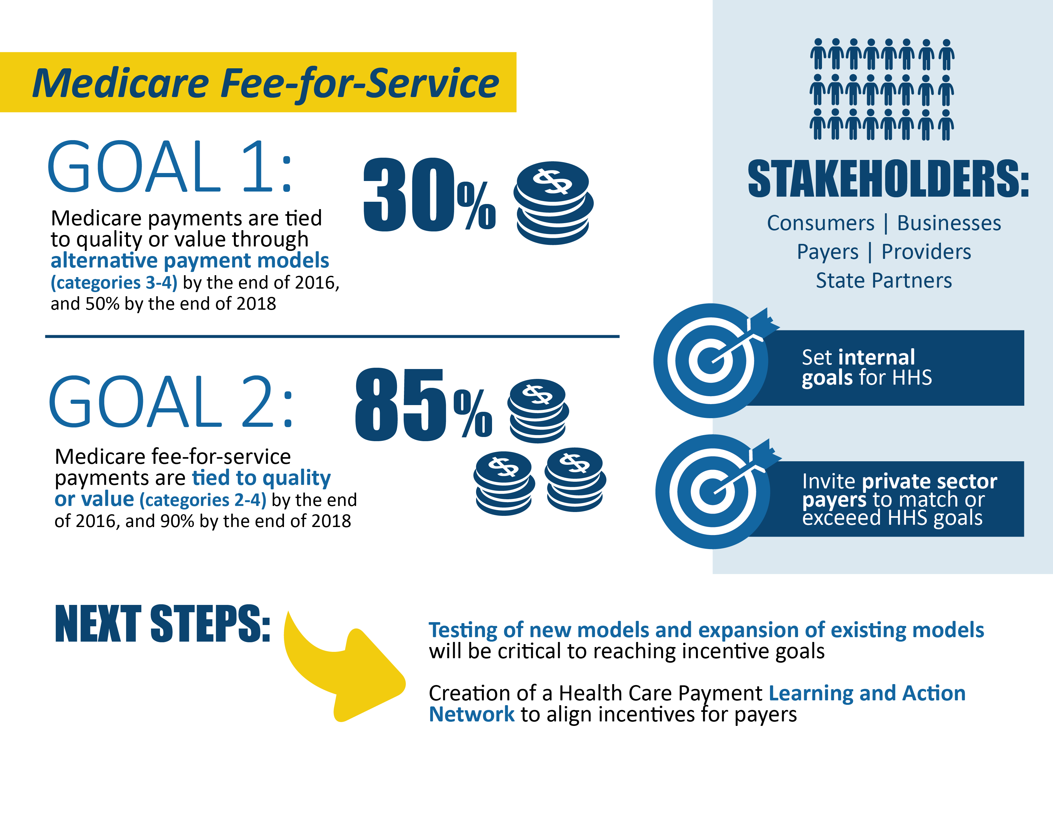
During January 2015, HHS announced goals for value-based payments within the Medicare FFS system
On March 3, 2016, President Obama and HHS announced that 30 percent of Medicare payments are tied to quality payments through APMs. This goal was achieved one year ahead of schedule!

Slide 3
The Health Care Payment Learning and Action Network will accelerate the transition to alternative payment models
Medicare alone cannot drive sustained progress towards alternative payment models (APM)
Success depends upon a critical mass of partners adopting new models
The network will
  Convene payers, purchasers, consumers, states and federal partners to establish a common pathway for success
  Identify areas of agreement around movement to APMs
  Collaborate to generate evidence, shared approaches, and remove barriers
  Develop common approaches to core issues such as beneficiary attribution
  Create implementation guides for payers and purchasers
Network Objectives
Match or exceed Medicare alternative payment model goals across the US health system
-30% in APM by 2016 (EXCEEDED)
-50% in APM by 2018
Shift momentum from CMS to private payer/purchaser and state communities
Align on core aspects of alternative payment design

Slide 4
The Innovation Center portfolio aligns with delivery system reform focus areas
Focus Areas
CMS Innovation Center Portfolio*
Pay Providers
Test and expand alternative payment models
Accountable Care
Pioneer ACO Model
Medicare Shared Savings Program (housed in Center for Medicare)
Advance Payment ACO Model
Comprehensive ERSD Care Initiative
Next Generation ACO
Primary Care Transformation
Comprehensive Primary Care Initiative (CPC)
Multi-Payer Advanced Primary Care Practice (MAPCP) Demonstration
Independence at Home Demonstration
Graduate Nurse Education Demonstration
Home Health Value Based Purchasing
Medicare Care Choices
Bundled payment models
Bundled Payment for Care Improvement Models 1-4
Oncology Care Model
Comprehensive Care for Joint Replacement
Initiatives Focused on the Medicaid
Medicaid Incentives for Prevention of Chronic Diseases
Strong Start Initiative
Medicaid Innovation Accelerator Program
Dual Eligible (Medicare-Medicaid Enrollees)
Financial Alignment Initiative
Initiative to Reduce Avoidable Hospitalizations among Nursing Facility Residents
Medicare Advantage (Part C) and Part D
Medicare Advantage Value-Based Insurance Design model
Part D Enhanced Medication Therapy Management
Deliver Care
Support providers and states to improve the delivery of care
Learning and Diffusion
Partnership for Patients
Transforming Clinical Practice
Community-Based Care Transitions
Health Care Innovation Awards
Accountable Health Communities
State Innovation Models Initiative
SIM Round 1
SIM Round 2
Maryland All-Payer Model
Million Hearts Cardiovascular Risk Reduction Model
Distribute Information
Increase information available for effective informed decision-making by consumers and providers
Health Care Payment Learning and Action Network
Information to providers in CMMI models
Shared decision-making required by many models
* Many CMMI programs test innovations across multiple focus areas

Slide 5
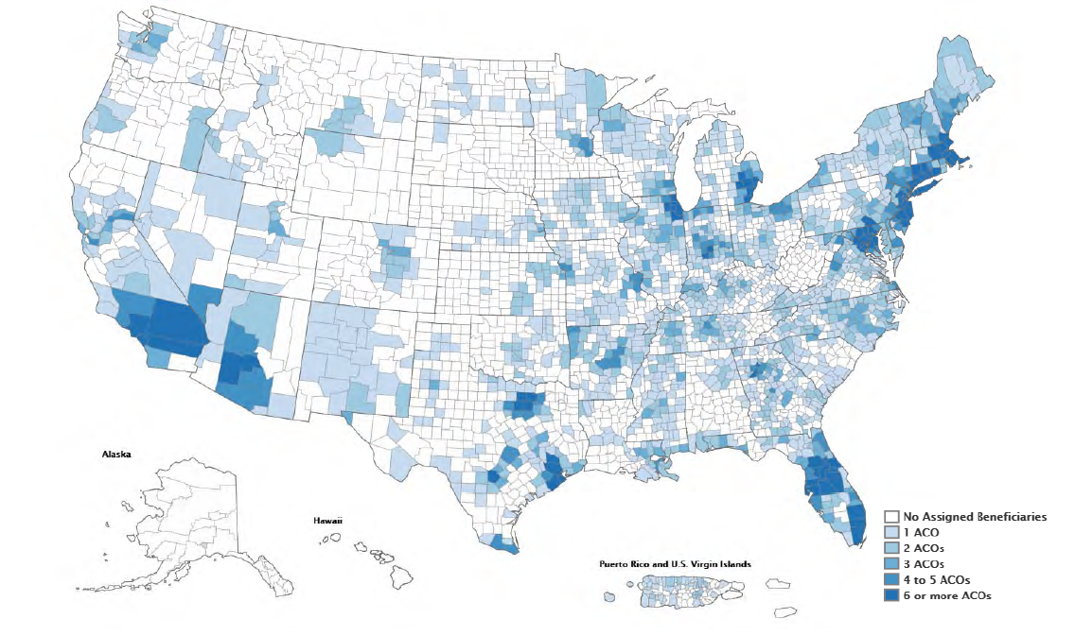
Accountable Care Organizations: Participation in Medicare ACOs growing rapidly
477 ACOs have been established in the MSSP, Pioneer ACO, Next Generation ACO and Comprehensive ESRD Care Model programs*
This includes 121 new ACOS in 2016 (of which 64 are risk-bearing) covering 8.9 million assigned beneficiaries across 49 states & Washington, DC
ACO-Assigned Beneficiaries by County**
* January 2016
** Last updated April 2015

Slide 6
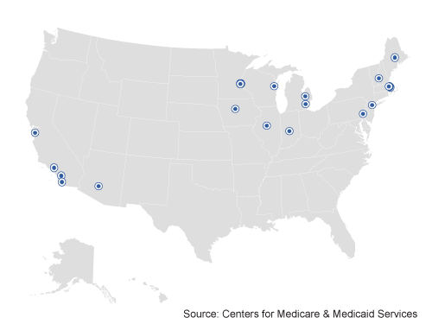
Pioneer ACOs meet requirement for expansion after two years and continued to generate savings in performance year 3
Pioneer ACOs were designed for organizations with experience in coordinated care and ACO-like contracts
Pioneer ACOs generated savings for three years in a row
  Total savings of $92 million in PY1, $96 million in PY2, and $120 million in PY3‡
  Average savings per ACO increased from $2.7 million in PY1 to $4.2 million in PY2 to $6.0 million in PY3‡
Pioneer ACOs showed improved quality outcomes
  Mean quality score increased from 72% to 85% to 87% from 2012–2014
  Average performance score improved in 28 of 33 (85%) quality measures in PY3
Elements of the Pioneer ACO have been incorporated into track 3 of the MSSP ACO
  19 ACOs operating in 12 states (AZ, CA, IA, IL, MA, ME, MI, MN, NH, NY, VT, WI) reaching over 600,000 Medicare fee-for-service beneficiaries
  Duration of model test: January 2012 – December 2014; 19 ACOs extended for 2 additional years
‡ Results from actuarial analysis

Slide 7
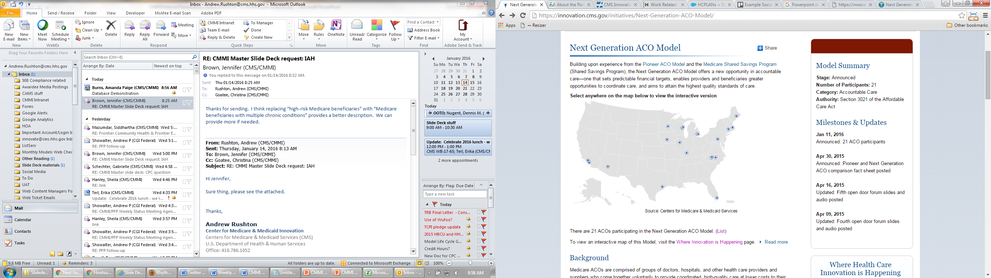
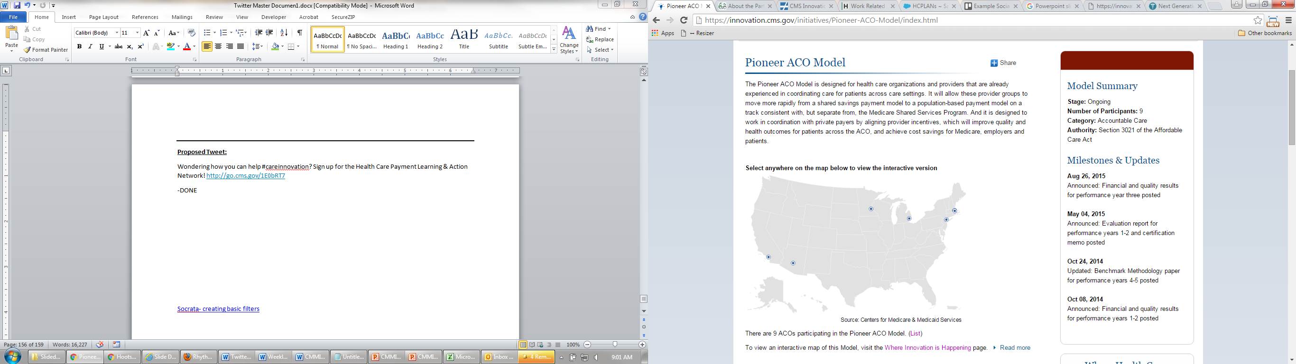
Next Generation ACO Model builds upon successes from Pioneer and MSSP ACOs
Model Principles
Designed for ACOs experienced coordinating care for patient populations
21 ACOs will assume higher levels of financial risk and reward than the Pioneer or MSSP ACOS
Model will test how strong financial incentives for ACOs can improve health outcomes and reduce expenditures
Greater opportunities to coordinate care (e.g., telehealth & skilled nursing facilities)
Prospective attribution
Financial model for long-term stability (smooth cash flow, improved investment capability)
Reward quality
Benefit enhancements that improve patient experience & protect freedom of choice
Allow beneficiaries to choose alignment
Next Generation ACO | Pioneer ACO
21 ACOs spread among 13 states | 9 ACOs spread among 7 states

Slide 8

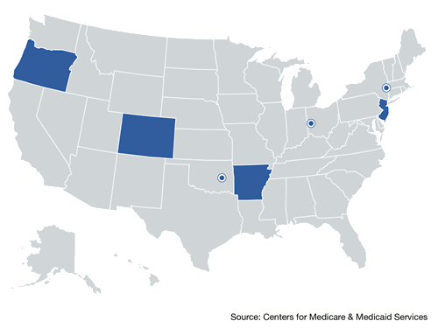
Comprehensive Primary Care (CPC) is showing early but positive results
CMS convenes Medicaid and commercial payers to support primary care practice transformation through enhanced, non-visit-based payments, data feedback, and learning systems
$14 or 2%* reduction part A and B expenditure in year 1 among all 7 CPC regions
Reductions appear to be driven by initiative-wide impacts on hospitalizations, ED visits, and unplanned 30-day readmissions
7 regions (AR, OR, NJ, CO, OK, OH/KY, NY) encompassing 31 payers, nearly 500 practices, and approximately 2.5 million multi-payer patients
Duration of model test: Oct 2012 – Dec 2016
* Reductions relative to a matched comparison group and do not include the care management fees (~$20 pbpm)

Slide 9
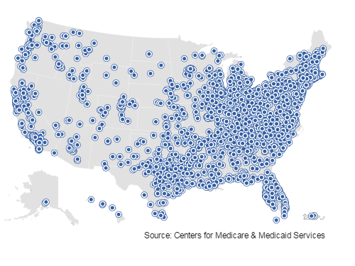
Bundled Payments for Care Improvement is also growing rapidly
The bundled payment model targets 48 conditions with a single payment for an episode of care
  Incentivizes providers to take accountability for both cost and quality of care
  Four Models
    Model 1: Retrospective acute care hospital stay only
    Model 2: Retrospective acute care hospital stay plus post-acute care
    Model 3: Retrospective post-acute care only
    Model 4: Prospective acute care hospital stay only
337 Awardees and 1237 Episode Initiators as of January 2016
Duration of model is scheduled for 3 years:
  Model 1: Awardees began Period of Performance in April 2013
  Models 2, 3, 4: Awardees began Period of Performance in October 2013

Slide 10
Comprehensive Care for Joint Replacement (CJR) will test a bundled payment model across a broad cross-section of hospitals
The model tests bundled payment of lower extremity joint replacement (LEJR) episodes and includes approximately 20% of all Medicare LEJR procedures
The model will have 5 performance years, with the first beginning April 1, 2016
Participant hospitals that achieve spending and quality goals will be eligible to receive a reconciliation payment from Medicare or will be held accountable for spending above a pre-determined target beginning in Year 2
Pay-for-performance methodology will include 2 required quality measures and voluntary submission of patient-reported outcomes data
selected Metropolitan Statistical Areas (MSAs)
~800 Inpatient Prospective Payment System Hospitals participating
67
U.S. population resides
where
30%
in

