Slide 1
Some Value(Able) Thoughts
Robert W. Dubois, MD, PhD
Chief Science Officer
rdubois@npcnow.org

Slide 2
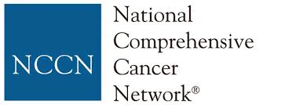
Value Frameworks Are Proliferating
Notes:
RD

Slide 3
Take-Home Messages
Value equation only looks simple (value = benefits/costs)
Today’s frameworks have much to teach, but improvements needed
Frameworks should align with guiding practices
Value assessments should not be nationally determined
No free lunch: balance access today with innovation tomorrow

Slide 4
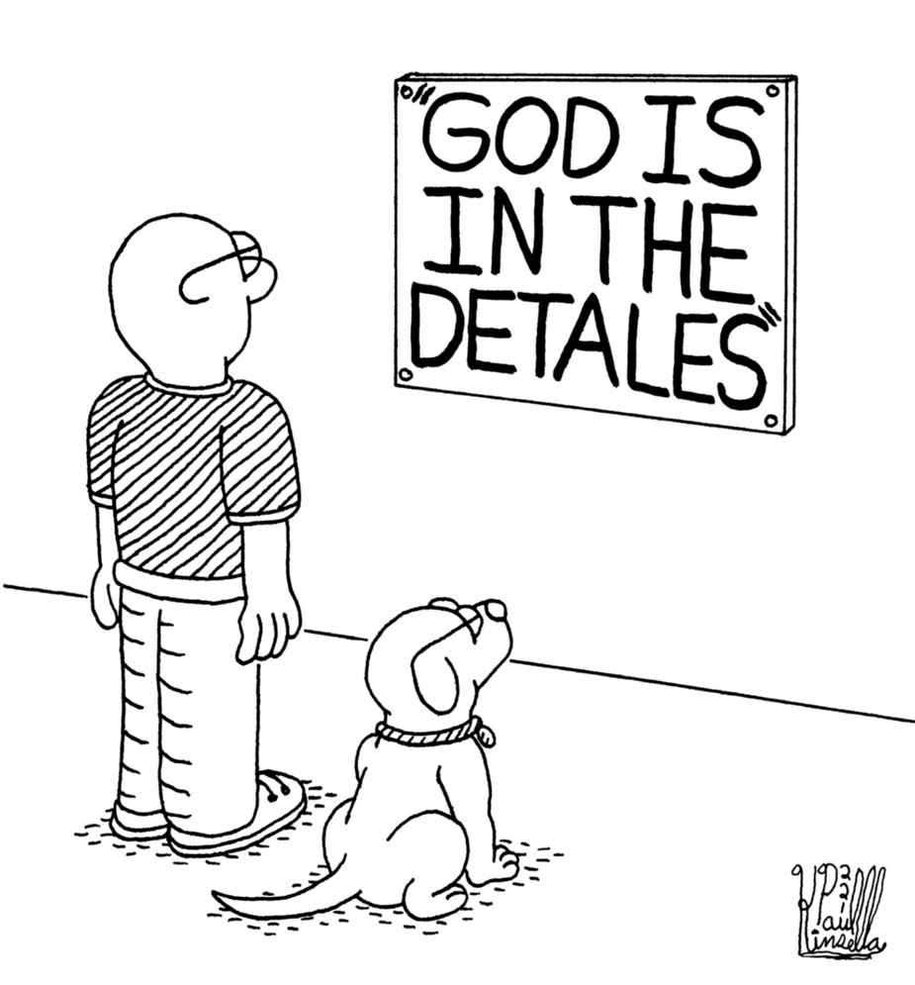
1. Value Equation Only Looks Simple (value = benefits/costs)
Benefits
Include all outcomes that matter
View over a long enough time interval
Consider individual treatment effects
Costs
Include all costs that matter
Use accurate costs
Incorporate productivity impact
Account for caregiver burden

Slide 5
2. Today’s Frameworks Have Much To Teach, But Improvements Needed
Lessons
Varying approaches
Differing audiences
Many considerations
Guiding Practices
Needed improvements
Full transparency
Stakeholder involvement
Validation/vetting

Slide 6
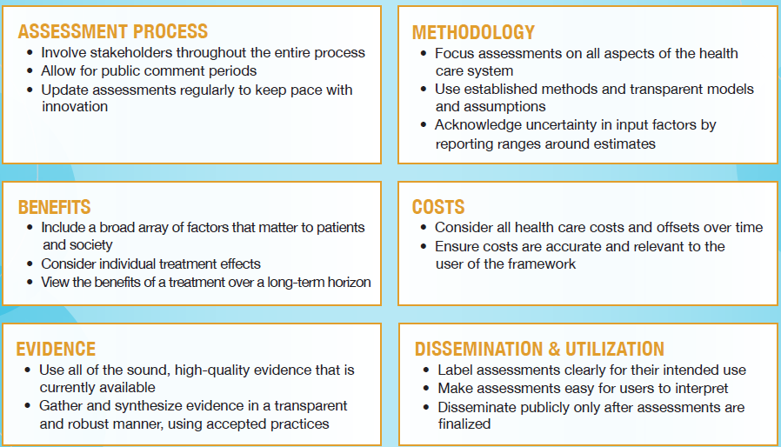
3. Frameworks Should Align With Guiding Practices*
*selection from NPC’s 35 Guiding Practices

Slide 7
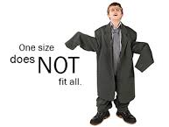
4. Value Assessment Should Not Be Nationally Determined
Patients differ (can’t just use the “average”)
Preferences differ
Value assessment needs to have flexibility by:
Population
Condition
Region of care

Slide 8
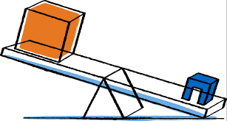
5. No Free Lunch: Balance Access Today With Innovation Tomorrow
Price Controls Creates Greater Access Today
Fewer Innovative Therapies Tomorrow

Slide 9
Take-Home Messages
Value equation only looks simple (value = benefits/costs)
Today’s frameworks have much to teach, but improvements needed
Frameworks should align with guiding practices
Value assessments should not be nationally determined
No free lunch: balance access today with innovation tomorrow

Slide 10
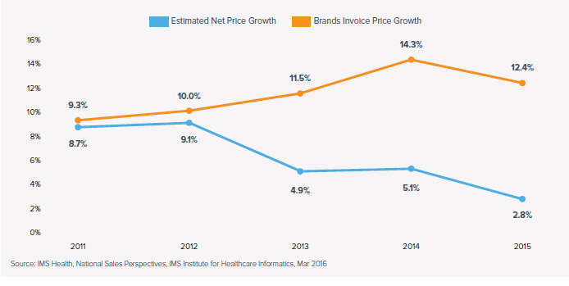
Beware of What (Headlines) You Read…

