Slide 1


Domestic Violence and Health: Understanding Root Causes and Policy Options
Wednesday, October 18, 2023

Slide 2


Sarah Dash, MPH
President and CEO
Alliance for Health Policy

Slide 3

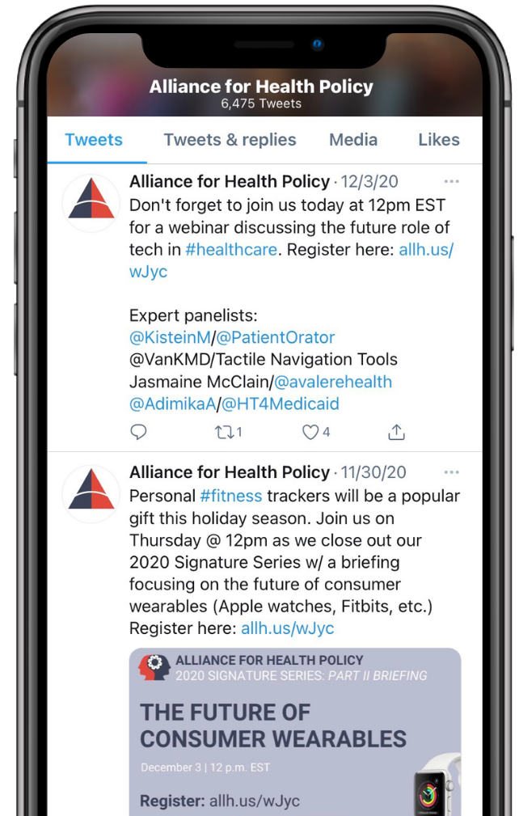


JOIN THE CONVERSATION
Alliance for Health Policy
Alliance for Health Policy
@AllianceforHealthPolicy
@AllianceforHealthPolicy
@AllHealthPolicy
Notes:
Medicare Series

Slide 4
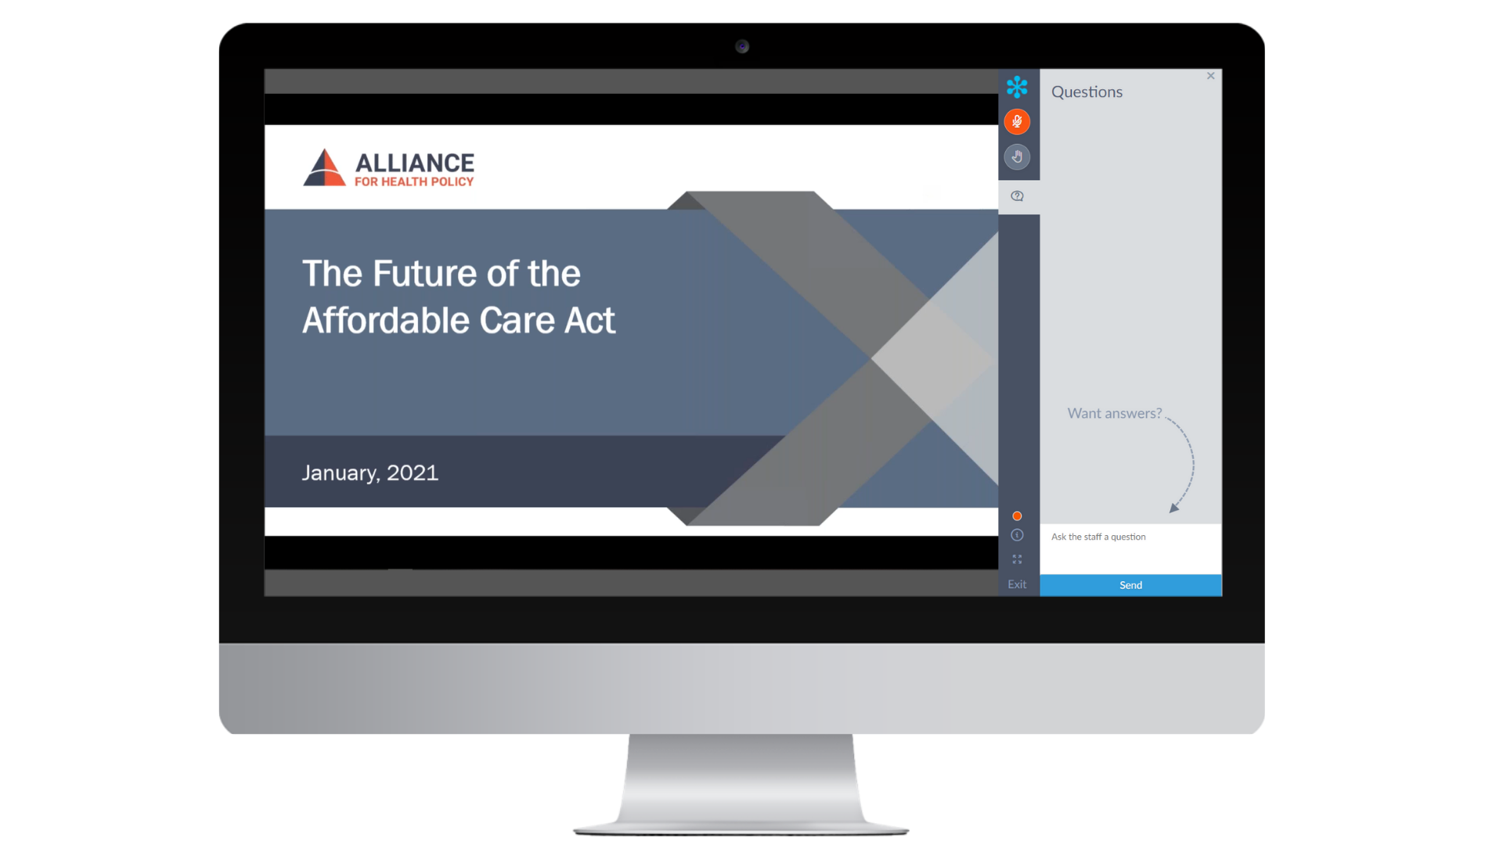
PARTICIPATING
To mute yourself, click the microphone icon. The icon will appear orange when muted.
To ask a question, click the ? icon and enter your question in the chat box below.

Slide 5


PARTNERS
Debbie Chang, MPH
President and CEO
Blue Shield of California Foundation

Slide 6

Arlene Vassell
Founding Director
TooREL Institute for Social Change

Slide 7



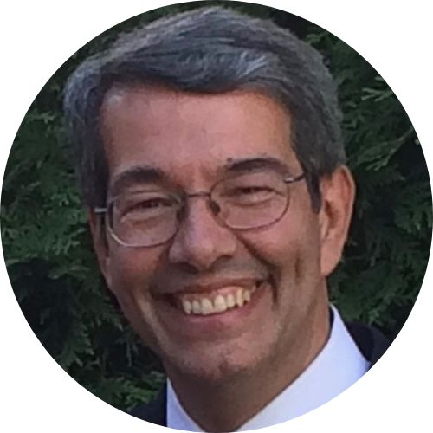
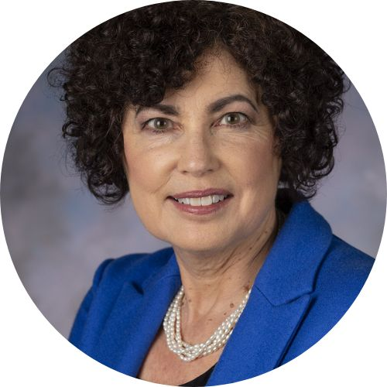
PRESENTERS
Brigid McCaw, M.D., MPH, M.S.
Clinical and Health Policy Consultant, UCLA-UCSF ACE’s Aware Initiative
L.Y. Marlow, MBA
CEO and Founder
Saving Promise
Lynn Rosenthal
HHS Director of Sexual and Gender-based Violence, U.S. Department of Health and Human Services
Juan Carlos Areán, Ph.D.
Program Director
Futures Without Violence
Notes:
Twitters

Slide 8
Poll Question #1
Is domestic violence preventable?
Yes
No

Slide 9
L.Y. Marlow, MBA
CEO and Founder
Saving Promise

Slide 10
GETTING TO THE ROOT OF IT.
Reimagining Intimate Partner Violence As A
Real Public Health Crisis

Slide 11
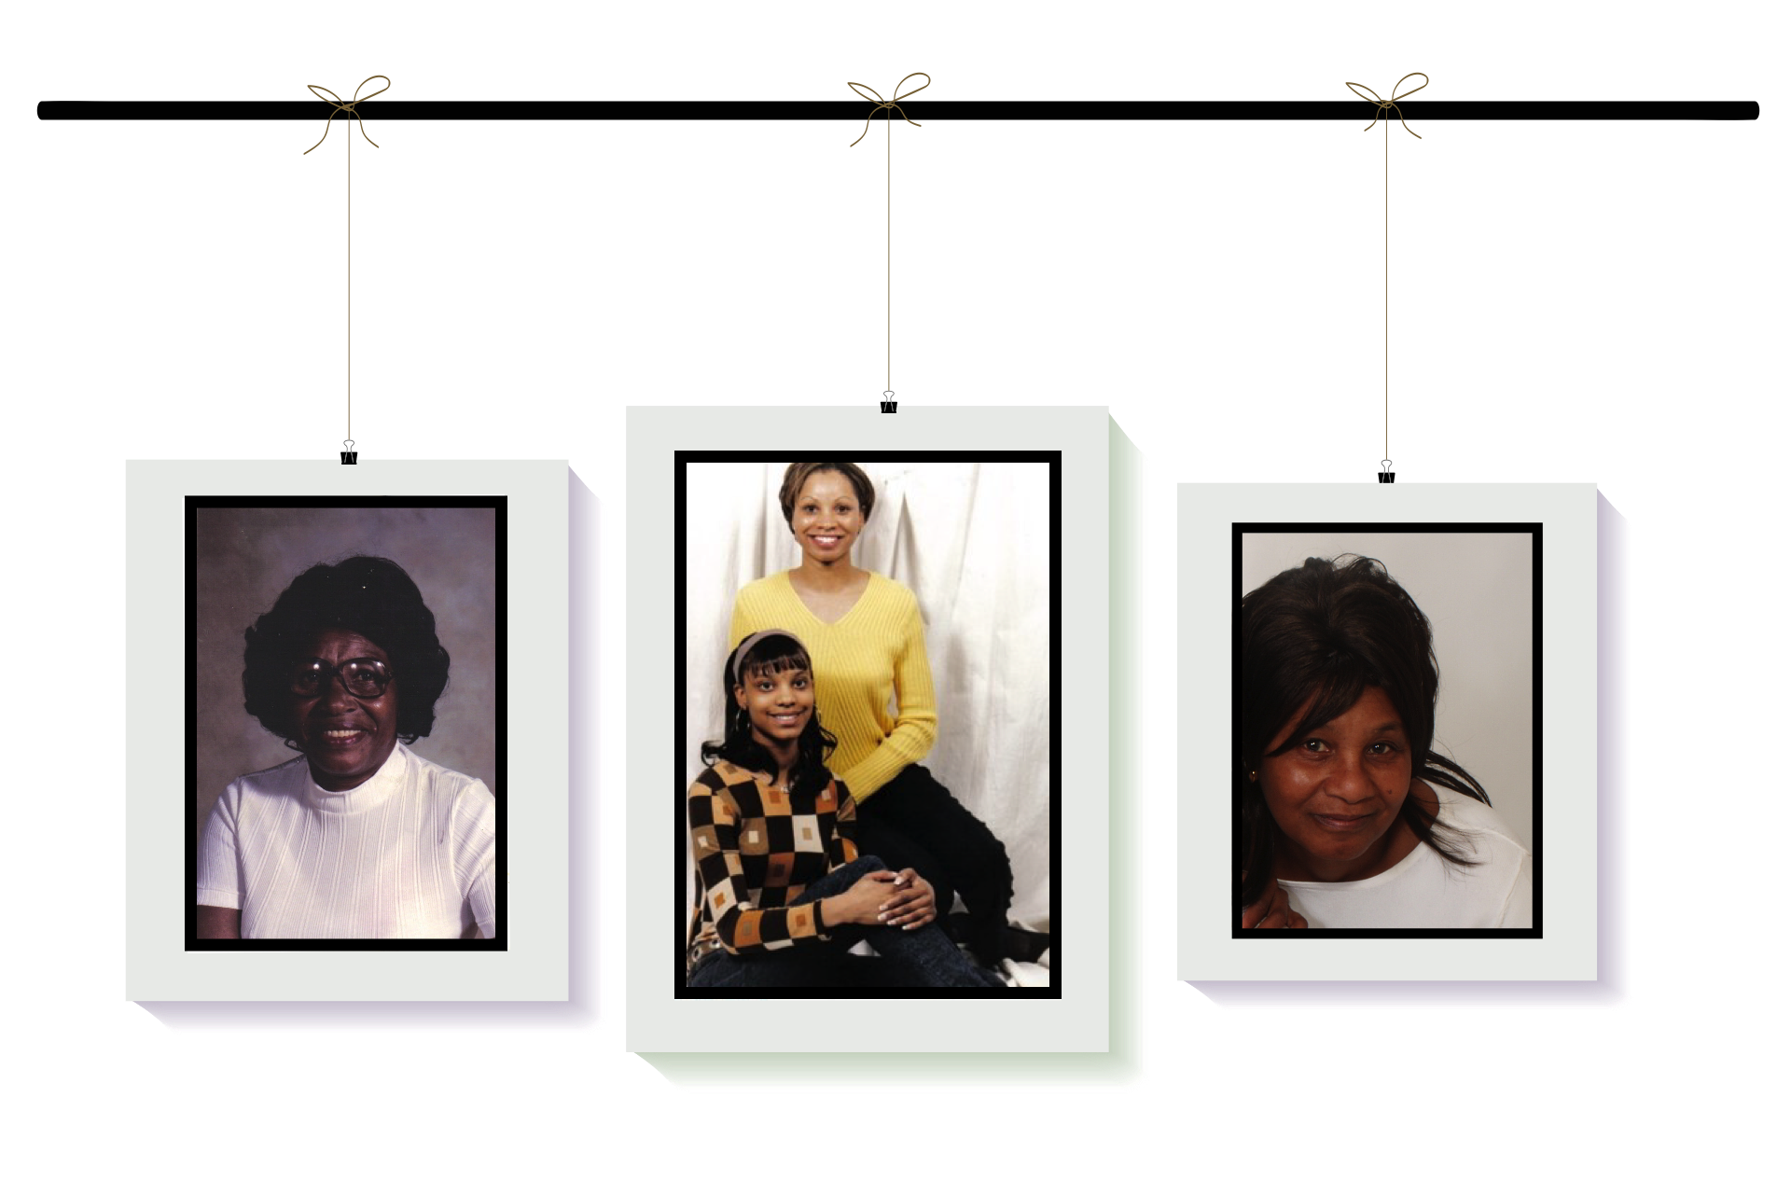
Notes:
L.Y. will share the Saving Promise story (capture the hearts).

Slide 12

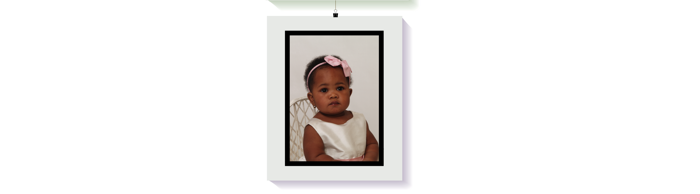
Notes:
L.Y. will share the Saving Promise story (capture the hearts).

Slide 13
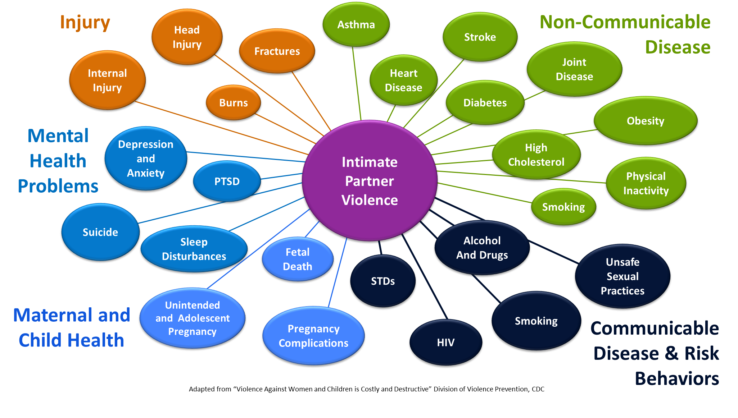
Daughter
(strangulation; head injuries, severe trauma, maternal)
L.Y.
(severe physical & emotional trauma, maternal health)
Promise
(pre-post mental, emotional, physical trauma)
Mother
(physical, mental and emotional acute trauma)
L.Y.
(PTSD, life threatening
health issues)
Grandmother
(physical, mental and emotional acute trauma)
Mother
(Terminal Lung Cancer)
Notes:
Bizu will present.

Slide 14
Daughter’s Boyfriend
(mental illness, substance abuse, violence)
This thing is REAL !!!
Daughter’s Father
(mental illness, substance abuse, trauma, violence)
PROMISE
(5th Generation)
Grandfather
(mental illness, substance abuse and emotional acute trauma)
Father
(mental illness, substance abuse and narcissistic)
Notes:
Bizu will present.

Slide 15
COMMUNITY | HEALTH | ECONOMICS
Increased levels of severe violence across the life span. | Increases in injuries, mental health, non-communicable and communicable diseases. | Anticipated increases in annual costs of IPV and related costs (est. $ trillions globally).
Higher rates of child abuse, bullying and teen dating violence. | Greater risk of emotional, behavioral, and physical problems, including depression, anxiety, and suicidal thoughts. | Higher costs to employers including diminishing productivity, absenteeism, lost wages, and health care costs.
Anticipated increases in intersections: mental health, suicide, homicides, poverty drug & alcohol, homelessness. | Increases of trauma related illnesses including maternal health, brain injuries, child development. | Increased costs in social services, law enforcement and other intersections and trauma related factors.
Continued perpetuation of stigmatized societal and cultural norms; silence. | Astronomical increases of healthcare costs. | Guess who’s paying for it?
IPV is a
Public Health Crisis READY TO ERUPT!!!
WHAT ARE THE RISK FACTORS

Slide 16

EVERY 11 MINUTES
A WOMAN OR GIRL IS KILLED BY AN
INTIMATE PARTNER OR FAMILY MEMBER.
– Antonio Guterres, U.N. Chief Secretary General, November 2022

Slide 17








Get Educated
Only 11 minutes to get educated.
Take Action
Explore 11 different ways you can take action.
Get Educated
Pass It On
Sponsor an individual, group or organization.
Only 11 Minutes to educate 11 essential sectors about intimate partner violence, how to stay safe, and what healthy looks like.
Notes:
Carla

Slide 18

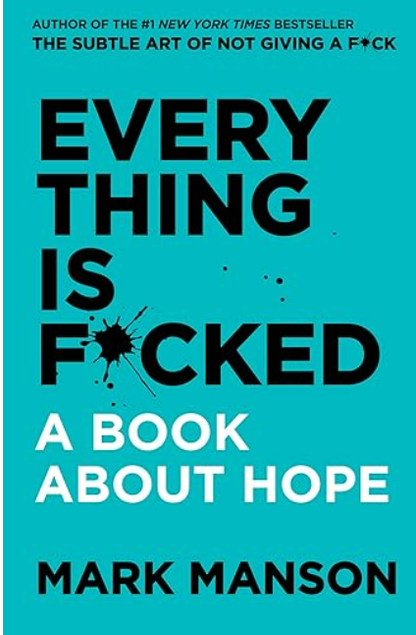


Slide 19
Brigid McCaw, M.D., MPH, M.S.
Clinical and Health Policy Consultant UCLA-UCSF ACE’s Aware Initiative

Slide 20

Domestic Violence and Health:
Understanding Root Causes and Policy Options
Brigid McCaw MD, MPH, MS, FACP
October 2023

Slide 21
Crucial Role of Health Care
Offers many points of access over the life course
Opportunities for identification, intervention and healing, as well as education and prevention
IPV has significant medical and mental health impact and cost
IPV can have inter-generational impact
Healthcare interventions make a difference

Slide 22
Health Consequences of IPV
Gynecologic & Urologic
Pregnancy & Peripartum
Other Conditions
HIV, STI
UTI
Unplanned pregnancy
Menstrual disorders
Pelvic pain
Dyspareunia
Menopausal symptoms
Incontinence
Obstetric complications
Perinatal depression, anxiety
Substance misuse
Death due to homicide or suicide
Preterm birth, low birth weight infant
Frequent Headaches
Difficulty sleeping
Gastrointestinal disorders
Palpitations
Fibromyalgia
Musculoskeletal conditions
Multiple physical symptoms
Injury
Chronic Conditions
MH & Substance Misuse
Strains, contusions, lacerations
Fractures
Head, neck, and facial injuries
Strangulation
Traumatic brain injury
Thoracic and abdominal injuries
Sexual assault
Homicide
Asthma
Diabetes
Cardiovascular (HTN, lipid disorders)
Stroke
Joint disease
Chronic pain
Depression
Anxiety disorders, including PTSD
Eating disorders
Suicidal behavior
Tobacco addiction
Misuse of alcohol and other drugs
Prescription and opioid misuse
Intimate Partner Violence. (2019) New England Journal of Medicine. 380(9):850-7, Miller E, McCaw B

Slide 23
Key Points
Psychological abuse: threats, humiliation, coercion, isolation can cause long term damage & impact health
Physiologic mechanism: acute & chronic stress related activation of
neuro-endocrine and immune system pathways
Long term consequences: increased risk for multiple medical & mental health conditions
Co-occurrence & intersectionality: IPV, SDOH, BH issues, other forms of trauma contribute to risk and must inform intervention.
Notes:
The title of this slide should say Key Points

Slide 24
Intersectionality
Recognizing the additional impact of:
  Systemic racism, historical trauma
  Sexism, gender identity & sexual orientation discrimination
  Inter-generational poverty
  War, global pandemics, climate change
Notes:
I want to pause here to recognize the intersectionality of trauma that many women experience. Here I’ve listed some examples.
systemic racism, historical trauma
sexism, gender identity and sexual orientation discrimination,
poverty, socio economic deprivation
war, global pandemics, climate change,
These are sources of toxic stress as well and a reminder that many women and girls are experiencing multiple types of adversity every day.
And the work we do to reduce the impact of trauma must specifically address these as well

Slide 25


Universal Screening for IPV for Childbearing-age Women
(Grade B recommendation)
Affordable Care Act
Screening and counseling for interpersonal and domestic violence required as part of women’s preventive health services
IPV screening and counseling should be core part of women’s health services
Women’s Preventive Health Care Services Committee
Notes:
The title of this slide should be Policy Matters

Slide 26
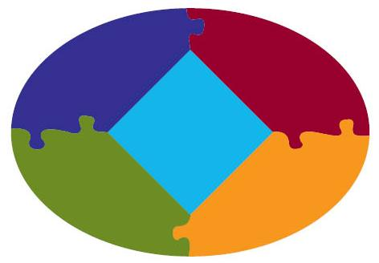
Transforming the Health Care Response to IPV
Systems-Model Approach
Inquiry and
Response
On-site
Services
Leadership
and
Oversight
Supportive
Environment
Community
Linkages
McCaw, B., et al., Beyond screening for domestic violence: a systems model approach in a managed care setting. Am J Prev Med, 2001.
Young-Wolff K, et al. Transforming the Health Care Response to Intimate Partner Violence: Addressing “Wicked Problems.” JAMA 2016.
Notes:
Kaiser Permanente Northern California’s coordinated approach to DV prevention is a comprehensive model for reducing DV through inquiry, identification, and referral. It was developed and tested in 1998 at the Kaiser Permanente facility in Richmond, California, and is currently being implemented at all KP facilities in the northern California Region. The program was designed to build on existing systems, thereby ensuring easy dissemination to all KP facilities and to provide a model that could be adapted to other health care settings. The program uses an interdisciplinary “systems model” approach.^{1,2}
Key features of the program include:
1. on-site services provided by mental health clinicians,
2. simplified inquiry and referral for front-line clinicians,
3. materials designed to create a supportive environment for the provider and members, and
4. linkages to community resources

Slide 27
Referral
Protocols
Builds on existing MH & social service resources
Clinician training
Inquiry and
Referral
On-site
Services
EHR
Tools
Leadership
and
Oversight
Supportive
Environment
Community
Linkages
Educational materials
Private rooming
Establish & promote community resources
Notes:
27
McCaw, B., et al., Beyond screening for domestic violence: a systems model approach in a managed care setting. Am J Prev Med, 2001. 21(3): p. 170-6.

Slide 28
Examples of Healthcare System Change
Veterans Health Administration
Catalyst Project, Health Resources Services Administration
Kaiser Permanente

Slide 29

Trauma & Resilience Informed Care
Changes the clinical focus from
What is WRONG
with you?
to
What HAPPENED
to you?

Slide 30
Trauma & Resilience Informed Care
Whole Person Approach
Healing is always possible
Competencies
Strengths
Protective
Factors &
Supports
Neuroplasticity

Slide 31
Contact Information
Brigid McCaw MD, MS, MPH, FACP
Brigid.McCaw@gmail.com
Clinical Advisor
  Center to Advance Trauma-informed Healthcare, University of California, San Francisco
  California Adverse Childhood Experiences (ACEs) Aware Initiative
Medical Director (Retired), Family Violence Prevention Program, Kaiser Permanente

Slide 32
Juan Carlos Areán, Ph.D.
Program Director
Futures Without Violence

Slide 33
Domestic Violence and Health: Understanding Root Causes and Policy Options
Juan Carlos Areán, Ph.D.
Futures Without Violence

Slide 34
Root Causes of Domestic Violence?
PATRIARCHAL MASCULINITY
Based on domination and power over
Intersects with other forms of supremacy
Learned through socialization
Complicated by trauma, mental illnesses, and substance abuse
Oppresses women and people of all genders, but also hurts men

Slide 35
Some strategies to engage men
IN PREVENTION AND INTERVENTION
Everyone can play a role and teach boys healthy masculinity
Men as positive role models and upstanders
Safe spaces for men and boys to talk
Use healthy masculinity to address men’s mental and physical health
Use culture and parenthood as motivators for change

Slide 36
Some policy recommendations
Expand programs to teach boys healthy masculinities (e.g., Coaching Boys Into Men)
Address men’s and boys’ mental health from a gender and racial justice perspective
Invest in interventions for men and young men who cause harm (including abusive partner intervention, restorative justice, and helplines)
Include DV in other violence prevention and support initiatives directed at men (e.g., community violence and fatherhood programs)

Slide 37
THANK YOU!
www.futureswithoutviolence.org
jcarean@futureswithoutviolence.org

Slide 38
Lynn Rosenthal
HHS Director of Sexual and Gender-based Violence, U.S. Department of Health and Human Services

Slide 39
The U.S. National Plan to End Gender-based Violence: Strategies for Action
Lynn Rosenthal
HHS Director of Sexual and Gender-Based Violence
Notes:
Welcome to the new OASH PowerPoint template. Each slide contains helpful information for making the entire presentation user-friendly and accessible to people of all abilities. **Disclaimer** Additional remediation is required after content has been added to this template to ensure 508 compliancy.
Please note: if your presentation is being posted to a .gov website, the PowerPoint must be converted and remediated as a PDF.

Slide 40


Executive Order 14020
Sec. 4. Implementation [of the National Gender Strategy] … (b) The Council shall coordinate a comprehensive, interagency response to gender-based violence at home and abroad, including intervention, prevention, and public health strategies to reduce incidence and impacts. . . . shall create a National Action Plan to End Gender-Based Violence that establishes a Government-wide approach to preventing and addressing gender-based violence in the United States and shall work, in conjunction with the Assistant to the President for National Security Affairs, to lead a comprehensive, interagency review and update of the 2016 United States Strategy to Prevent and Respond to Gender-Based Violence Globally…” (EO 14020, §4(b).
LINK TO EO 14020

Slide 41
VISION STATEMENT
The United States will be a place where all people live free from gender-based violence
(GBV) in all aspects of their lives.
This vision applies to all people, regardless of gender, sex, gender identity, sex characteristics, sexual orientation, race, ethnicity, religion, age, disability, geographic location, national origin, immigration or citizenship status, socioeconomic circumstance, medical condition or status, or
other factors.

Slide 42

Guiding Principles
Centering
Centering the voices of survivors
Addressing
Addressing GBV through a public health, public safety, and life course lens
Recognizing
Recognizing GBV as a form of gender discrimination
Promoting
Promoting federal leadership and coordination across sectors
Adopting
Adopting an intersectional approach
Grounding
Grounding policies and programs in evidence and research
Embracing
Embracing a rights-based approach

Slide 43
7 Pillars
Prevention
Support, Healing, Safety, Wellbeing
Economic Security and Housing Stability
Online Safety
Legal and Justice Systems
Emergency Preparedness and Crisis Response
Research and Data

Slide 44
Health Strategies in the National Plan
Apply health-based strategies to prevent GBV, such as comprehensive and behavioral health support for people who are using violence against intimate partners or family members
Promote workplace GBV and equity policies for health care systems, including measures to create safe, trauma-informed healthcare facilities, so patients and providers alike can deliver and access care in an environment of dignity and respect.
Promote routine screening and brief counseling for intimate partner violence by health care providers, as a covered preventive service for women of reproductive age through the Affordable Care Act with no additional cost for patients.
Support the development of screening tools and health care interventions for all forms of GBV.
Ensure that health care systems actively work to address social determinants of health and violence prevention, including by addressing housing, homelessness, and food insecurity

Slide 45
Moderated Q & A

Slide 46

TAKE OUR SURVEY
Please fill out the evaluation survey you will receive after this presentation!
Title
Details
www.allhealthpolicy.org
Notes:
Medicare Series

Slide 47
UPCOMING EVENTS
2023 Signature Series Congressional Briefing: November 1
2023 Annual Alliance Dinner: November 15
*Please contact kappenzeller@allhealthpolicy.org for sponsorship opportunities!
allh.us/events
Notes:
Medicare Series

Slide 48
THANK YOU FOR ATTENDING!

