Slide 1
Navigating Complex Systems: Care and Policies for Dual-Eligible Beneficiaries
Tuesday, December 12, 2023

Slide 2
Alison Jones, MPH
Director of Program Strategy and Management
Alliance for Health Policy

Slide 3
PARTNERS

Slide 4
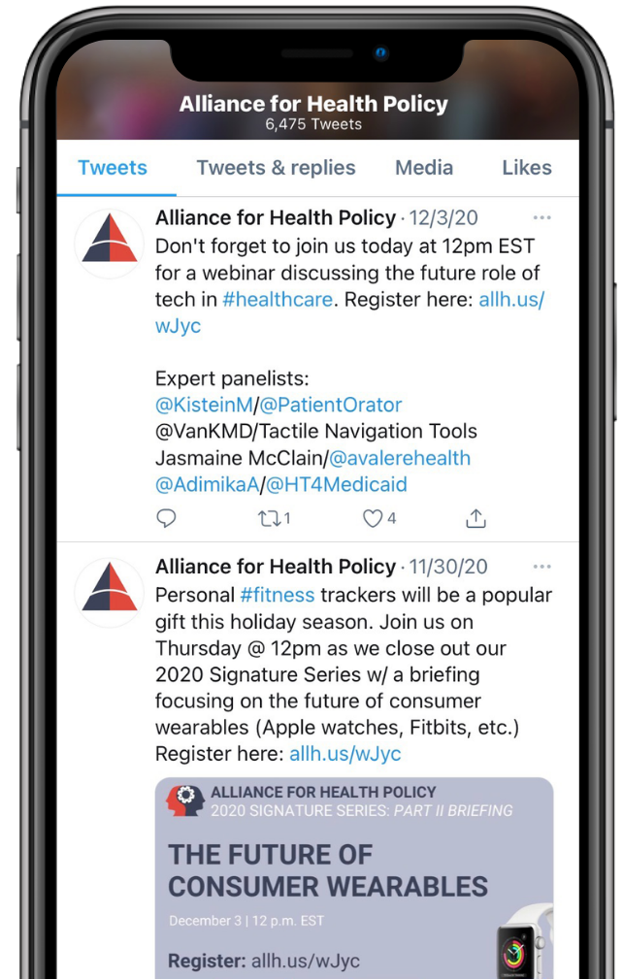
JOIN THE CONVERSATION
@AllHealthPolicy
Alliance for Health Policy
Alliance for Health Policy
@AllianceforHealthPolicy
@AllianceforHealthPolicy
Notes:
Medicare Series

Slide 5
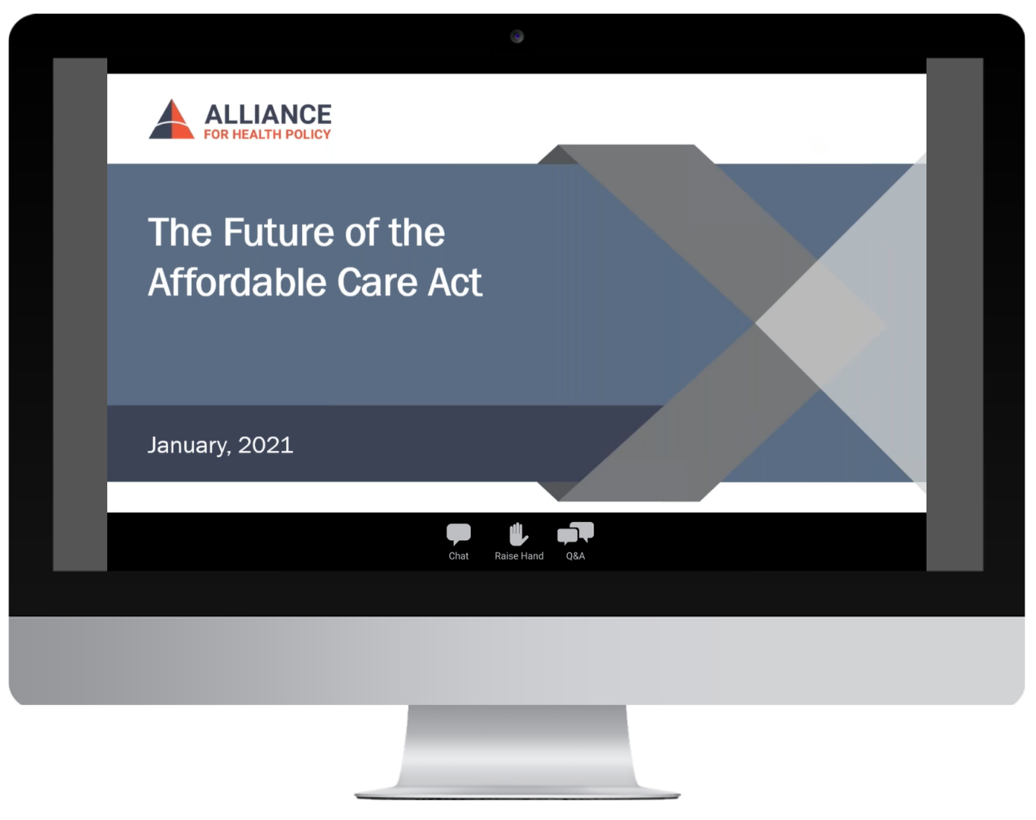
PARTICIPATING
To ask a question click the Q&A button and enter your text in the chat box.

Slide 6
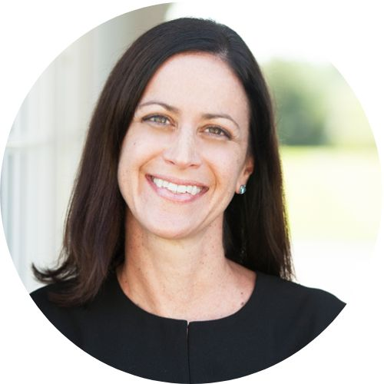
MODERATOR
Allison Hamblin, MSPH
President & CEO
Center for Health Care Strategies

Slide 7
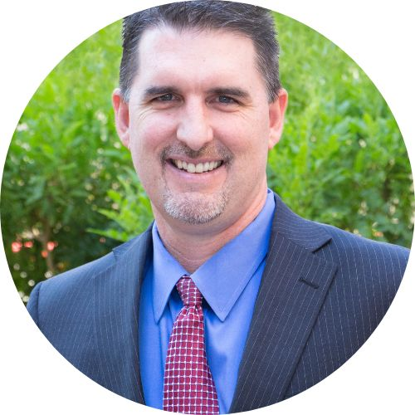
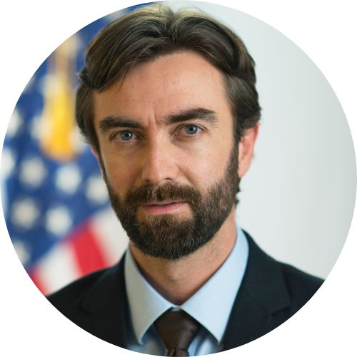
PANELISTS
Allison Hamblin, MSPH
President & CEO
Center for Health Care Strategies
Thomas Betlach, MPA
Partner
Speire Healthcare Strategies
Dennis Heaphy, D.Min., M.Div., M.Ed., MPH
Policy Analyst/Researcher
Disability Policy Consortium
Tim Engelhardt, MHS
Director of Federal Coordinated Health Care Office
Centers for Medicare and Medicaid Services
Notes:
D.Min., M.Div., M.Ed., MPH

Slide 8
Allison Hamblin, MSPH
President & CEO
Center for Health Care Strategies

Slide 9
Understanding Dually Eligible Populations: Who, How, and Why
Navigating Complex Systems: Care and Policies for Dual-Eligible Beneficiaries
Alliance for Health Policy
Allison Hamblin, Center for Health Care Strategies
December 12, 2023

Slide 10
Over 12 Million Dually Eligible Individuals Are Covered by Both Medicaid and Medicare
Medicare 64.5 million
Medicaid 89.3 million
Dually Eligible
12.2 M
Based on 2020 Medicare and Medicaid enrollment.

Slide 11
How People Become Dually Eligible
Must qualify for Medicare
Age 65 or older
Under age 65 with a disability
End-stage renal disease
Must qualify for Medicaid
Meet income and asset requirements
Be a member of an eligible group
Of all dually eligible individuals
About half became Medicare eligible due to age, and half to disability
About half of full-benefit dually eligibles became Medicaid eligible through SSI
Source: Medicare Payment Advisory Commission (MedPAC) and Medicaid and CHIP Payment and Access Commission (MACPAC). “Data Book: Beneficiaries Dually Eligible for Medicare and Medicaid.” February 2023. www.macpac.gov/wp-content/uploads/2023/02/Feb23_MedPAC_MACPAC_DualsDataBook-WEB-508.pdf

Slide 12
Characteristics of Dually Eligible Populations
59% female
46% racial/ethnic minority
35% live alone
21% live in rural communities
34% no high school diploma
47%
mental health condition
34% limitations with 2+ ADLs
49% use long-term services and supports
More common among those under age 65
More common among those age 65 and older
Sources: Medicare Payment Advisory Commission (MedPAC) and Medicaid and CHIP Payment and Access Commission (MACPAC). “Data Book: Beneficiaries Dually Eligible for Medicare and Medicaid.” February 2023. www.macpac.gov/wp-content/uploads/2023/02/Feb23_MedPAC_MACPAC_DualsDataBook-WEB-508.pdf; and Peña, M., Mohamed, M., Burns, A., Fuglesten Biniek, J., Ochieng, N., and Chidambaram, P. “A Profile of Medicare-Medicaid Enrollees (Dual Eligibles).” Kaiser Family Foundation, January 2023. www.kff.org/medicare/issue-brief/a-profile-of-medicare-medicaid-enrollees-dual-eligibles/ ; and Medicare-Medicaid Coordination Office. “People Dually Eligible for Medicare and Medicaid.” March 2019. www.integratedcareresourcecenter.com/sites/default/files/DuallyEligibleIndividualsFactSheet03112019.pdf

Slide 13
Dually Eligible Individuals Account for Disproportionate Enrollment and Spending
Source: Medicare Payment Advisory Commission (MedPAC) and Medicaid and CHIP Payment and Access Commission (MACPAC). “Data Book: Beneficiaries Dually Eligible for Medicare and Medicaid.” February 2023. www.macpac.gov/wp-content/uploads/2023/02/Feb23_MedPAC_MACPAC_DualsDataBook-WEB-508.pdf

Slide 14
Dually Eligible Individuals: Which Program Pays for What?
Medicare |  | Medicaid
Hospital care (Part A) Skilled nursing facility care (up to 100 days) (Part A) Home health care (Part A) Hospice (Part A) Physician and ancillary services (Part B) Durable medical equipment (DME) (Part B) Prescription drugs (Part D) |  | Medicare cost sharing Nursing home care (once Medicare benefits exhausted) Home- and community-based services (HCBS) Hospital care once Medicare benefits exhausted Some prescription drugs and DME not covered by Medicare

Slide 15
Misalignments Between Medicare and Medicaid
Overlapping Benefits
Medicare and Medicaid cover different benefits and services, but some may be covered by both programs (e.g., nursing facilities, home health, durable medical equipment)
Medicare is the primary payer
Administrative Processes
Separate beneficiary communications and notices
Separate identification cards
Separate enrollment processes, assessments, care planning
Separate grievance and appeals processes
Payment/Financing
Cost-shifting between states and federal government and different providers (e.g., hospitals and nursing facilities)
Institutional bias
1MG3-4G5-JC89

Slide 16
Challenges Resulting from a Lack of Integration
Gaps, duplication, fragmentation, and uncoordinated care and systems
Difficulty in navigating care
Disparities in access: Dually eligible individuals are less likely to:
Have a regular source of care or have access specialist care¹
Receive home- and community-based services or hospice²
Disparities in outcomes: Dually eligible individuals are more likely to:
Be hospitalized or readmitted to a hospital within 30 days of discharge^{3,4}
Be discharged to SNFs with low nurse-to-patient ratios and more likely to become long-stay nursing home residents if treated in SNFs with low nurse-to-patient ratios⁵
1. Johnson, K., Wen, H., and Pollack, H. “Comparison of Ambulatory Care Access and Quality for Beneficiaries With Disabilities Covered by Medicare Advantage vs Traditional Medicare Insurance.” JAMA Health Forum. 2022; 3(1).
2. Temkin-Greener, H., Guo, W., Hua, Y., Li, Y., Caprio, T., Schwartz, L., and Cai, S. “End-Of-Life Care In Assisted-Living Communities: Race and Ethnicity, Dual Enrollment Status, and State Regulations. Health Affairs. 2022; 41(5): 654–666.
3. Wadhera, R., Wang, Y., Figueroa, J., Dominici, F., Yeh, R. Maddox, K. “Mortality and Hospitalizations for Dually Enrolled and Non-Dually Enrolled Medicare Beneficiaries Aged 65 Years or Older, 2004 to 2017. JAMA. 2020; 323(10): 961-969.
4. Silvestri, D., Goutos, D., Lloren, A., Zhou, S. Zhou, G., Farietta, T., Charania, S., Herrin, J., Peltz, A., Lin, Z., and Bernheim, S. “Factors Associated With Disparities in Hospital Readmission Rates Among US Adults Dually Eligible for Medicare and Medicaid.” JAMA Health Forum. 2022;3(1).
5. Rahman, M. Gozalo, P., Tyler, D., Grabowski, D., Trivedi, A., and Mor, V. “Dual Eligibility, Selection of Skilled Nursing Facility, and Length of Medicare Paid Post-Acute Stay. Med Care Res Rev. 2014 Aug; 71(4): 384–401.

Slide 17
Dennis Heaphy, D.Min., M.Div., M.Ed., MPH
Policy Advocate/Researcher
Disability Policy Consortium

Slide 18
The Dual Eligible Perspective
Alliance for Health Policy: Duals webinar
Dennis Heaphy DMin, MPH, MEd, MDiv
Disability Policy Consortium

Slide 19
About us by us
Credo of the Disability Policy Consortium
Notes:
We must go beyond the adage "nothing about us without us" and recognize that at every level of the system dual eligibles must be engaged in developing, implementing, evaluating and advancing programs in the healthcare delivery system is to meet their needs.

Slide 20
"There is no such thing as a single-issue struggle because we do not live single-issue lives."
Audre Lorde
Notes:
Health equity is about understanding intersectional strengths and barriers to health of people. African-American civil rights Activist Audre Lorde was legally blind from childhood, a lesbian and a mother. She understood the compounding effects of disparities rooted in historical bias and discrimination. In addressing the needs of the duals population, it is essential that plans to build comprehensive strategies for addressing health inequities understanding that inequities are not "single issue" struggles and therefore cannot be addressed using a medical model cookie-cutter approach to addressing the social needs of duals.

Slide 21
Rights Guaranteed Under The Americans With Disabilities Act (ADA)
Are Only As Meaningful As
An Individual's Opportunity To Access Those Rights.
Notes:
Persons with disabilities are the only group of Americans whose access to civil rights is predicated on access to services needed to realize those rights is determined by a states medical necessity guidelines or a health plans determination of need policies. A person trapped in a nursing home, a person living in the community without adequate or appropriate home and community-based services including medical and nonmedical transportation has no ability to engage in the community in a meaningful way. It is therefore the responsibility of healthcare delivery system to ensure people have access to the services they require to meaningfully live in the community.

Slide 22
What a person actually needs is not a tensionless state
but rather the striving and struggling for some goal
worthy of her.
Viktor Frankl
Notes:
Why I won't go for an overnight procedure Story about cat.
Living with a disability is challenging, it is especially challenging when an individual is treated as a patient and that label becomes their identifier in life. People need meaning and purpose. No, healthcare cannot alleviate some of the challenges inherent in disability, but it can remove the tensions that create barriers to a person's moving beyond that identity as a patient, cripple, crazy person or drug addict,
As recognized by SAMSHA healthcare can assist people in Overcoming or managing disease and living in a physically and emotionally healthy way. Home: a stable and safe place to live. Purpose: meaningful daily activities, such as a job, school, volunteerism and family. Community: relationships and social networks that provide support, friendship, love and hope.
Health plans can provide people with Choice, control and dignity of risk.
These are not abstractions. The healthcare delivery system is to focus more on upstream need of individuals if they are to improve their quality of life. These include community health workers, certified peer specialists, certified recovery coaches and other peers.
It also requires plans as described by one CMS policymaker "break the code book" and provide services people need that are not defined by medical necessity requirements or determination of need policies. Yes, there is misalignment between Medicare Medicaid, however, particularly in capitated systems, plans have an obligation to provide things like a computer gaming system so that someone can reach out beyond their four walls

Slide 23
"I don't trust words, I trust actions."
Aman Ullah
Notes:
I do not know the origin of this quote, but it rings true the duals population there is an inherent distrust among dual eligibles whether because of racism, ableism, stigma, denial of services or denial of access to providers. The healthcare delivery system has to earn the trust of dual eligibles.
Barbara McGinnis, one of the founders of healthcare for the homeless in Massachusetts put it this way " Take your time. Listen to patients’ stories. Respect their dignity. Be consistent. Offer care and hope, and never judge. Address people by name. Remember that the core of the healing art is the personal relationship."
This is very challenging to find today when care coordination is done remotely by coordinators who have an inherent conflict of interest, insurance companies utilization management practices use restrictive and opaque artificial intelligence algorithms, and insurance companies focus on quick turnaround ROI to meet the needs of investors rather than members is tough to trust. I am empathetic with the challenges faced by states which have tight budgets, calls for reduced taxes and limited capacity to provide adequate and appropriate oversight of plans which can outspend and outmaneuver them.

Slide 24
People Not Patient needs
Socioeconomic status
Education
Housing and Neighborhood Conditions
Social Support Networks
Health Literacy
Behavioral and Lifestyle
Cultural and Social Identity
Individual goals and aspirations
Notes:
Nearly one quarter (24%) of younger beneficiaries with disabilities had incomes less than $10,000 per year and two-thirds (67%) had incomes less than $20,000 per year, compared to 13% and 39%, respectively, of older beneficiaries.
Less than high school education
Unsafe inaccessible neighborhoods-food deserts, limited or no transportation (rural vs urban vs suburban
High levels of isolation and loneliness
Challenges navigating system, lack of trust
(Substance use disorder, schizophrenia, dementia or Alzheimer’s
Racism, homophobia, stigma compounding effects of ableism and other aspects of identity

Slide 25
Meaning and Person-Centered Care
Value-Consumer leadership-governance and oversight at all levels - CMS, state, plan levels
Civil Rights Model of care-integrating Independent Living and Recovery Model
Conflict free trust based care plan development and implementation
Rebalancing services - Build system that focuses on addressing nonmedical social drivers of health and individual nonmedical life goals/needs

Slide 26
Establish Measurable Goals That Matter
Evidence-based measures of consumer engagement impact on state and federal policies
Set benchmarks:
Reduction in disparities between disability populations and general population
Reduction in disparities between BIPOC populations with disabilities and white persons with disabilities
Increased investment in:
home and community-based services (HCBS)
Increased investment in nonmedical services that address social drivers of health and individual life goals
Notes:
Choice-MA plans, PPOs, fee-for-service
Increased oversight-market is dominated by Medicare advantage plans with questionable evidence of benefit
Do away with low value plans (such as Chronic Condition SNPs)
Focus on transitioning all D-SNPs to FIDE-SNPs
Bending the cost curve - not focusing on savings
Address misalignment between Medicare and Medicaid
Integrate Behavioral Health and Medical
Break the codebook with person-centered nonmedical services
Valid care plans that reflect independent and recovery goals of members
Utilization management and AI protocols that are transparent and promote access to services that advance member goals
Equity goals that are measurable
Require all dual plans to be coordinated by state Medicaid offices to prevent plans from overpromising and under delivering
Transparency

Slide 27
Tim Engelhardt, MHS
Director of Federal Coordinated Health Care Office
Centers for Medicare and Medicaid Services

Slide 28
Improving Access to Medicare Savings Programs (MSPs)
MSPs are eligibility groups through which state Medicaid agencies cover Medicare premiums and, in many cases, other cost sharing
Despite their importance, the MSPs are undersubscribed
Medicare Improvements for Patients and Providers Act (MIPPA) (2008)
CMS Rulemaking: Streamlining Medicare Savings Program Eligibility Determination & Enrollment (2023)

Slide 29
Advancing Integrated Care
Creating systems that are more about the person than the two programs
Receiving Medicare and Medicaid benefits through the same organization
Financial Alignment Initiative demonstrations
Bipartisan Budget Act of 2018
CMS Rulemaking: 2023 MA & Part D Final Rule, 2025 MA & Part D NPRM currently out for public comment

Slide 30
Thomas Betlach, MPA
Partner
Speire Healthcare Strategies

Slide 31
Moderated Q & A

Slide 32
TAKE OUR SURVEY
Please fill out the evaluation survey by using the link in the chat or via email this afternoon!
Title
Details
www.allhealthpolicy.org
Notes:
Medicare Series

Slide 33
UPCOMING EVENT
Title
Details
2024 Health Policy Forecast: January
allh.us/events
Notes:
Medicare Series

Slide 34
THANK YOU FOR ATTENDING!

