Slide 1
What’s Coming in 2024?
Health Policy Forecast for the New Year
Wednesday, January 24, 2024

Slide 2
Alison Jones, MPH
Director of Program Strategy and Management
Alliance for Health Policy

Slide 3
PARTNER

Slide 4
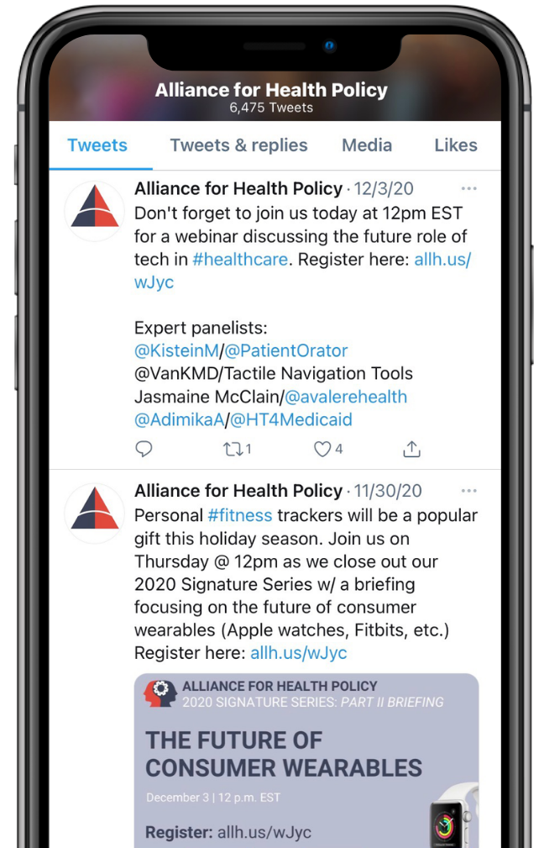
JOIN THE CONVERSATION
@AllHealthPolicy
Alliance for Health Policy
Alliance for Health Policy
@AllianceforHealthPolicy
@AllianceforHealthPolicy
Notes:
Medicare Series

Slide 5
PARTICIPATING
To ask a question click the Q&A button and enter your text in the chat box.

Slide 6
MODERATOR
Julie Rovner
Chief Washington Correspondent
KFF Health News

Slide 7
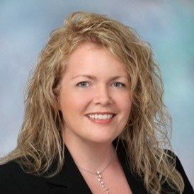
PANELISTS
Sarah Kuehl Egge, MPP
Principal & Founding Partner, SplitOak Strategies
Hemi Tewarson, J.D., MPH
Executive Director, National Academy of State and Health Policy (NASHP)
Nicholas Uehlecke
Principal, Todd Strategy Group
Notes:
D.Min., M.Div., M.Ed., MPH

Slide 8
Moderated Q & A

Slide 9
TAKE OUR SURVEY
Please fill out the evaluation survey by using the link in the chat or via email this afternoon!
www.allhealthpolicy.org
Notes:
Medicare Series

Slide 10
UPCOMING EVENT
Feb. 1 - Perspectives for Media on Value-Based Care in 2024
allh.us/events
Notes:
Medicare Series

Slide 11
THANK YOU FOR ATTENDING!

