Slide 1
Perspectives for Media on Value-Based Care in 2024
Thursday, February 1, 2024

Slide 2
Alison Jones, MPH
Director of Program Strategy and Management
Alliance for Health Policy

Slide 3
PARTNERS

Slide 4
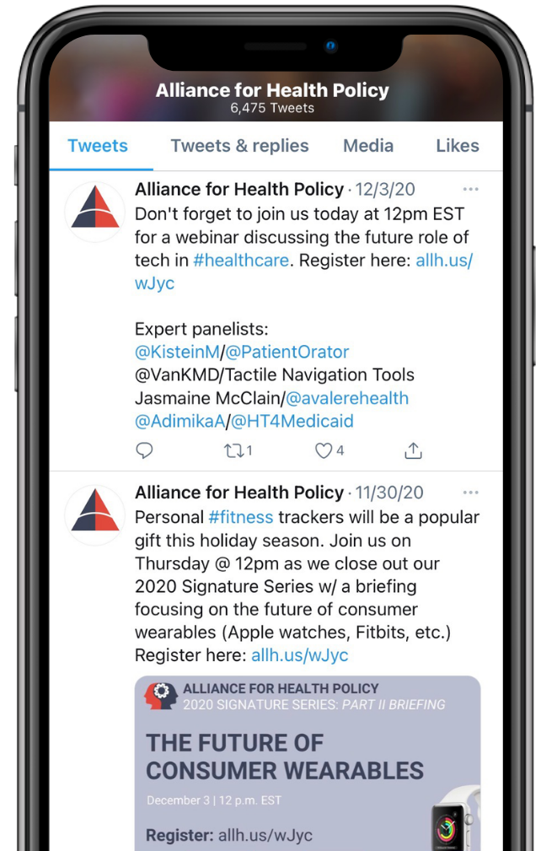
JOIN THE CONVERSATION
@AllHealthPolicy
Alliance for Health Policy
Alliance for Health Policy
@AllianceforHealthPolicy
@AllianceforHealthPolicy
Notes:
Medicare Series

Slide 5
PARTICIPATING
To ask a question click the Q&A button and enter your text in the chat box.

Slide 6
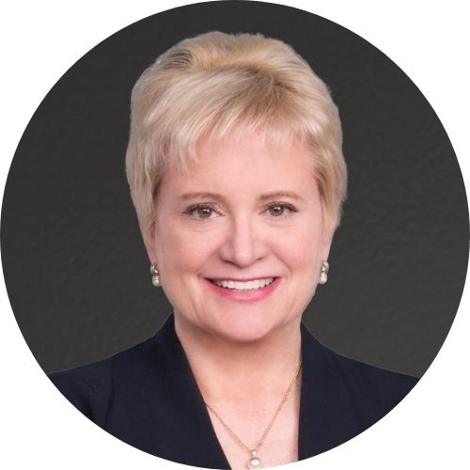
MODERATOR
Susan Dentzer, M.S.
President & CEO
America’s Physician Groups

Slide 7
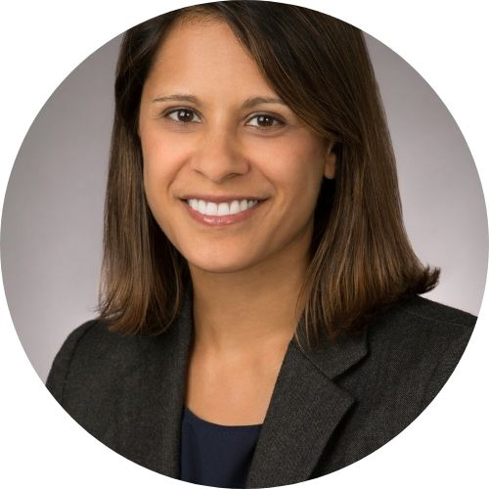
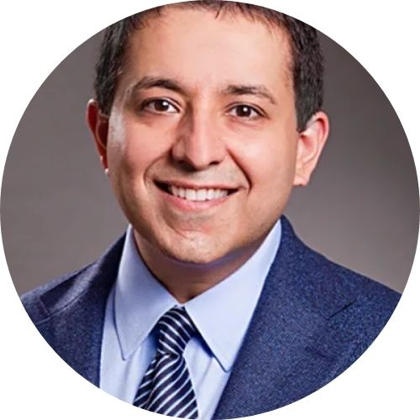
PANELISTS
Purva Rawal, Ph.D.
Chief Strategy Officer
CMS Innovation Center
Sarah Levin, MPH
Deputy Staff Director, Health Subcommittee
Committee on Ways and Means
David Pittman
Director, Communications and Regulatory Affairs
National Association of ACOs
Anshu Choudhri, MHS
Vice President, Policy Development and Strategy
Blue Cross Blue Shield Association
Notes:
D.Min., M.Div., M.Ed., MPH

Slide 8
Moderated Discussion

Slide 9
Moderated Q & A

Slide 10
TAKE OUR SURVEY
Please fill out the evaluation survey by using the link in the chat or via email this afternoon!
Title
Details
www.allhealthpolicy.org
Notes:
Medicare Series

Slide 11
Claire Sheahan, MSc.
President and CEO
Alliance for Health Policy

Slide 12
THANK YOU FOR ATTENDING!

