Slide 1
Navigating Complex Systems: Policy Opportunities for Dually Eligible Individuals
Thursday, March 28, 2024

Slide 2
Alison Jones, MPH
Director of Program Strategy and Management
Alliance for Health Policy

Slide 3
PARTNERS

Slide 4
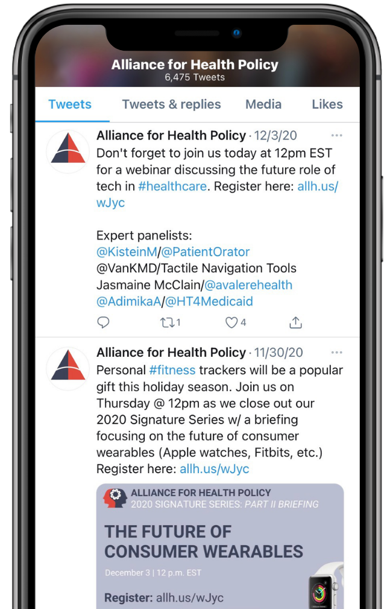
JOIN THE CONVERSATION
@AllHealthPolicy
Alliance for Health Policy
Alliance for Health Policy
@AllianceforHealthPolicy
@AllianceforHealthPolicy
Notes:
Medicare Series

Slide 5
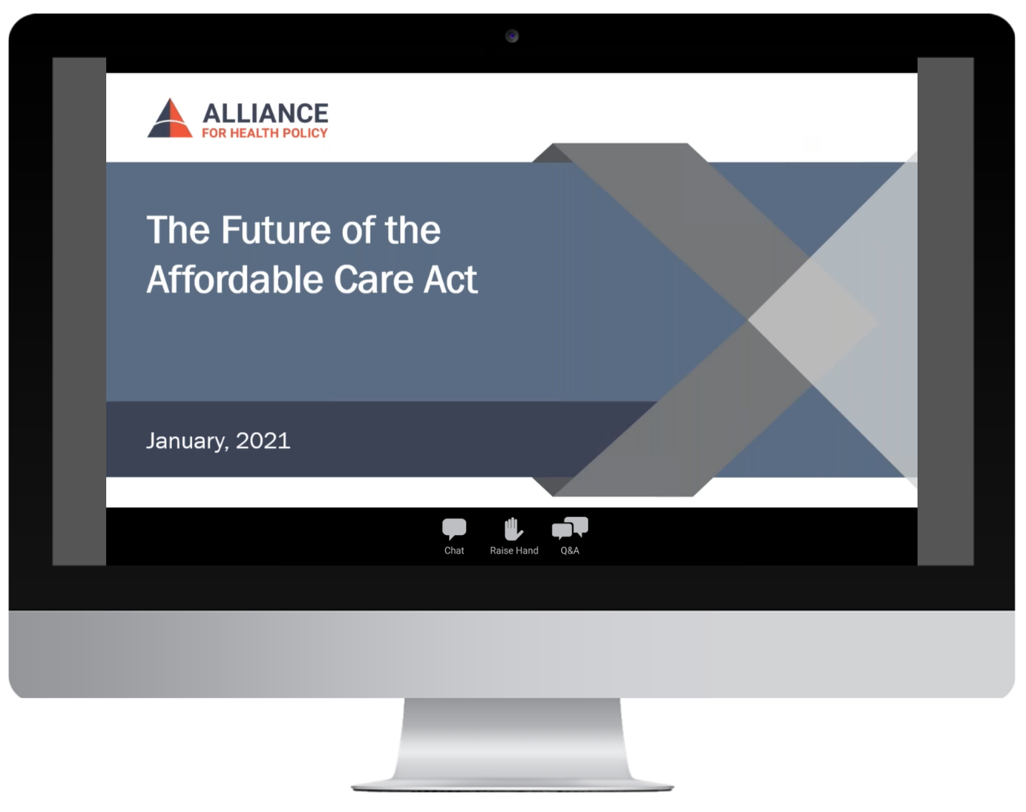
PARTICIPATING
To ask a question click the Q&A button and enter your text in the chat box.

Slide 6
MODERATOR
Brie Janoski, MPH
Managing Director
ATI Advisory

Slide 7
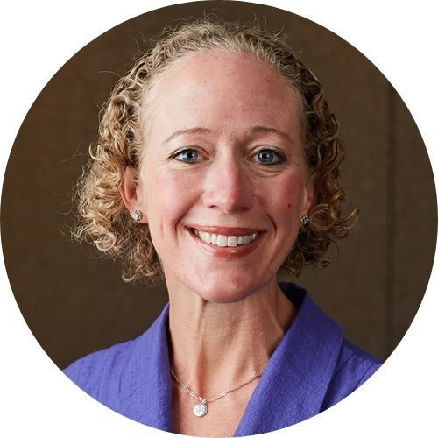
PANELISTS
Marcus Johnson, M.S., MSW
Advocacy Programs & Initiatives Manager
Independence Care System
Alice Burns, Ph.D., MPP
Associate Director, Program on Medicaid and the Uninsured
Kaiser Family Foundation
Michelle Herman Soper, MHS
Vice President of Federal Policy & Advocacy
Commonwealth Care Alliance
Kate Massey, MPA
Medicaid and CHIP Payment and Access Commission
Notes:
D.Min., M.Div., M.Ed., MPH

Slide 8
Marcus Johnson, M.S., MSW
Advocacy Programs & Initiatives Manager
Independence Care System

Slide 9
Alliance for Health Policy:
Navigating Complex Systems: Policy Opportunities for Dual Eligible Individuals
Marcus Johnson, Manager, Advocacy Programs & Initiatives / March 28, 2024

Slide 10
Let’s Talk! | Why Advocacy Is Important
Ensuring that the voices of individuals who are impacted by decisions are heard.
FACT: People with disabilities have high rates of chronic health conditions yet poorer access to healthcare.
Opportunity to educate and influence legislators, policymakers, consumers, and others on issues that are important.
FACT: The need for disability training for healthcare providers is well established.
Chance to change the outcome of a public policy.
FACT: For people with disabilities who have a combination of Medicaid and Medicare, plans often default to the lesser benefit. Provider networks are inadequate, and care coordinators lack the knowledge or experience to assist people with disabilities in navigating a complex healthcare system.
The CDC indicates that 61 million adults in the United States live with a disability, and 27 percent
(one in 4) of adults in the United States have some type of disability.

Slide 11
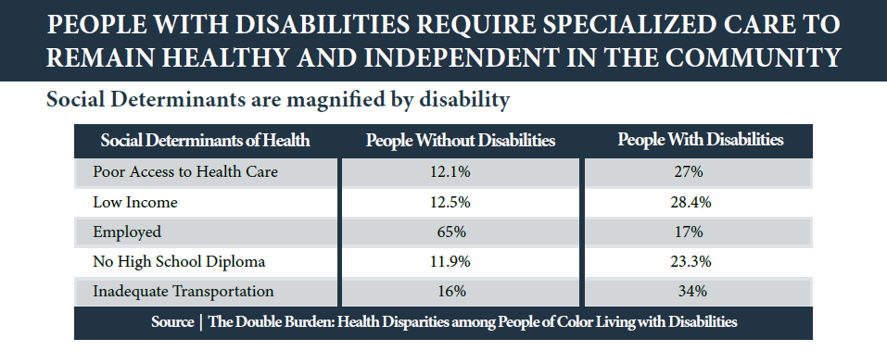
Social Determinants Of Health

Slide 12
Civics League For Disability Rights | Independence Care System
The Civics League for Disability Rights (CLDR) is an independent, volunteer-led group of New Yorkers with disabilities who advocate for themselves and the community while sharing ideas, tools, and information about how to effect change.
ICS is a community of professionals dedicated to serving people with disabilities and is the only health home program designated by New York State as experts in working with people with physical disabilities. We focus on the health, mobility and independence of members to help them be active, engaged members in the community.

Slide 13
Dually Eligible Challenges
Accessing the care and services needed to remain independent in the community is complicated due to the differences in Medicare and Medicaid coverage for wheelchairs, medical supplies, and specialty mattresses/support surfaces—all services necessary for keeping us healthy and mobile in the community.
Issues with timely receipt of needed services and supplies. Often, delays occur due to the poor integration and coordination of Medicare and Medicaid.
Medicaid payers insist on having a denial from Medicare before authorizing payment. This unnecessary process continues, despite the fact that the Centers for Medicare and Medicaid Services has instructed state Medicaid directors to authorize services based on the medical need of the member and NOT require a denial.
Challenges faced by dually eligible consumers can improve when integrated plans are designed to meet the needs of adults with disabilities—if there is the will on the part of policymakers to include those of us living with disabilities in the design.

Slide 14
Include Our Lived Experiences!
Integrated plans would meet the needs of dually eligible individuals if they included our lived experiences, and achieved the following:
Included people with disabilities on advisory committees to inform plan design and ensure needs are met without daily struggles.
Established adequate rates covering essential services for independent living, such as complex rehab technology and home care.
Implemented care coordination by disability-competent providers, creating person-centered care plans and maximizing benefits efficiency.
Remember: The care of individuals is not complex!
The system is complex, and equal is not equitable.

Slide 15
Thank You!!
For more information, contact: marcus.johnson@icsny.org

Slide 16
Alice Burns, Ph.D., MPP
Associate Director, Program on Medicaid and the Uninsured
Kaiser Family Foundation

Slide 17
Policy Opportunities for Dually Eligible Individuals
Alliance for Health Policy
Alice Burns
Associate Director with KPMU

Slide 18
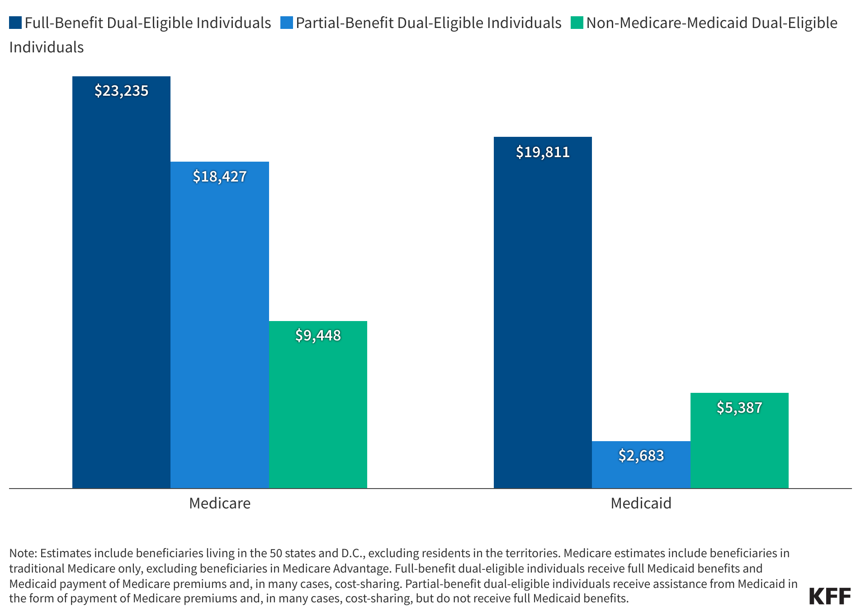
Dual-eligible enrollees have higher per-person costs than other Medicare or Medicaid beneficiaries.
Per person Medicare and Medicaid spending by benefit status in 2019
KFF, Enrollment and Spending Patterns Among Medicare-Medicaid Enrollees, https://www.kff.org/medicaid/issue-brief/enrollment-and-spending-patterns-among-medicare-medicaid-enrollees-dual-eligibles/.

Slide 19
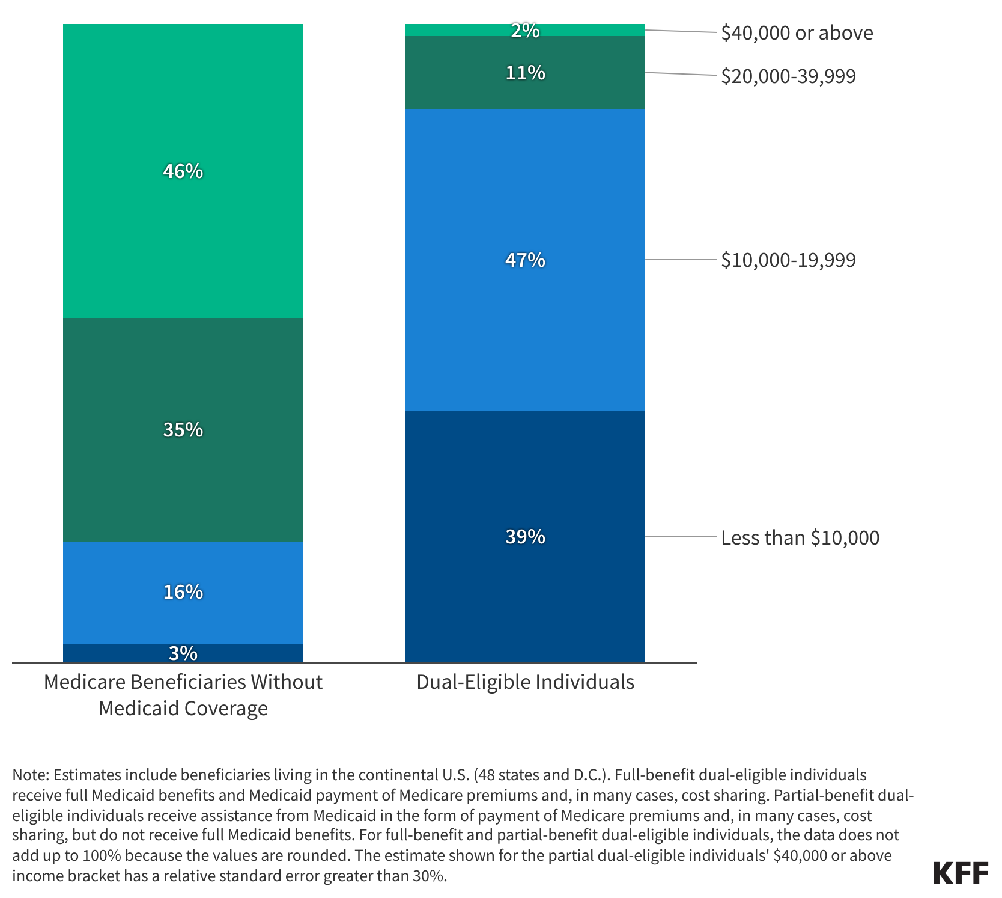
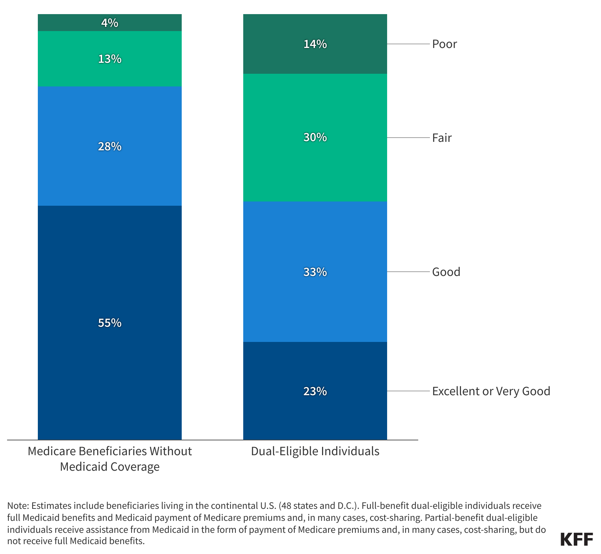
Dual-eligible individuals are a heterogeneous group, but generally have low incomes and significant health needs.
Income of Medicare beneficiaries by Medicaid coverage, 2020
Health status of Medicare beneficiaries by Medicaid coverage, 2020
KFF, A Profile of Medicare-Medicaid Enrollees, https://www.kff.org/medicare/issue-brief/a-profile-of-medicare-medicaid-enrollees-dual-eligibles/

Slide 20
There is a long history of efforts to integrate Medicare and Medicaid, with many current options available.
Understanding how those efforts work requires understanding how people receive their Medicare and Medicaid coverage.
Medicaid coverage
Medicare coverage
Joint coverage
Fee-for-service
Comprehensive managed care
Noncomprehensive managed care
Traditional Medicare
Medicare Advantage
Dual-eligible special needs plans (D-SNPs)
Coordination-only D-SNPs
Highly-integrated D-SNPs or “HIDEs” (since 2021)
Fully-integrated D-SNPs or “FIDEs”
Program of All-Inclusive Care for the Elderly (PACE)
Financial Alignment Initiative (including Medicare-Medicaid Plans or MMPs)

Slide 21
Fewer Than 5% of Dual-Eligible Individuals Are Enrolled in Joint Coverage Arrangements
Type of Medicare coverage and number of dual-eligible individuals enrolled in 2020
Traditional Medicare
51% (5,600k)
Coordination-Only D-SNPs
17% (1,900k)
Individual MA Plans
17% (1,900k)
Medicare-Medicaid Plans 3% (400k)
FIDE SNPs 3% (300k)
Other SNPs 2% (200k)
PACE 0.4% (50k)
Note: Includes the 10.9 million dual-eligible individuals with both Medicare Part A and Part B in March 2020. Previous KFF analysis included people who only had Part A or Part B, as well as those that were dual-eligible at any point during the year, and thus had 12.5 million dual-eligible individuals. Individual MA plans include employer-sponsored group plans, which comprise about 1% of dual-eligible individuals, as well as non-Medicare Advantage private plans (cost plans and HCPPs). SNP refers to special needs plans. Other SNPs includes institutional SNPs and chronic condition SNPs.
Source: KFF, How do Dual-Eligible Individuals Get Their Medicare Coverage, https://www.kff.org/medicare/issue-brief/how-do-dual-eligible-individuals-get-their-medicare-coverage/

Slide 22
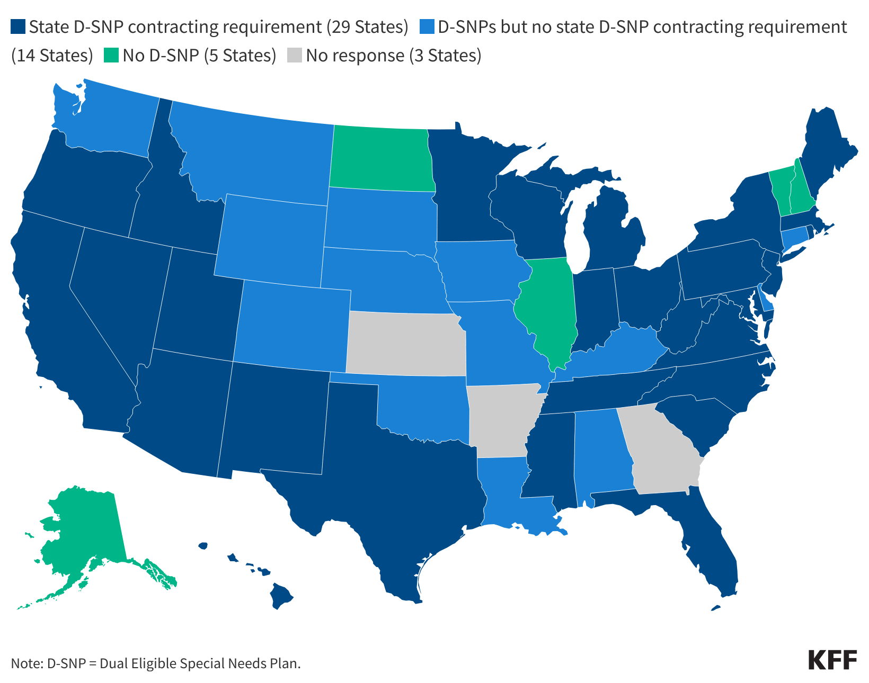
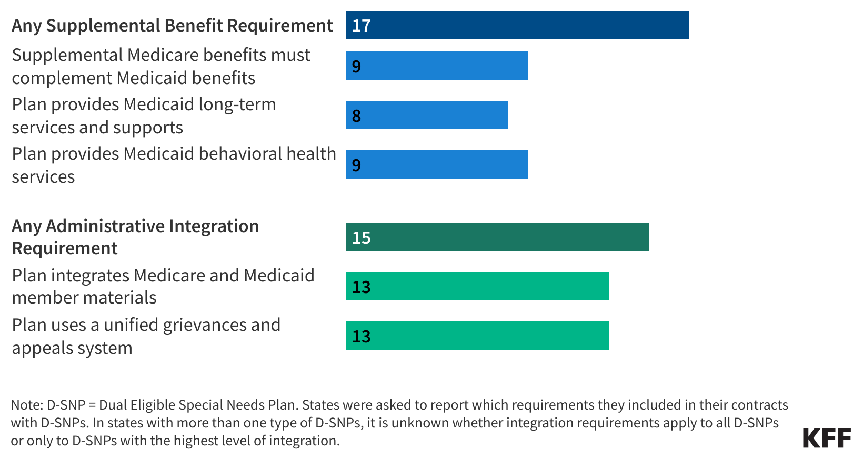
More than half of the states are leveraging their contracts with D-SNPs to support integration between Medicare and Medicaid
States with integration requirements in D-SNP contracts, 2022
Types of requirements states included, 2022
KFF, Medicaid Arrangements to Coordinate Medicare and Medicaid for Dual-Eligible Individuals, https://www.kff.org/medicaid/issue-brief/medicaid-arrangements-to-coordinate-medicare-and-medicaid-for-dual-eligible-individuals/.

Slide 23
THANK YOU
For more information, contact: aliceb@kff.org

Slide 24
Michelle Herman Soper, MHS
Vice President of Federal Policy & Advocacy
Commonwealth Care Alliance

Slide 25
Alliance for Health Policy: Navigating Complex Systems: Policy Opportunities for Dually Eligible Individuals Michelle Herman Soper March 28, 2024
Leading the way in transforming the nation’s healthcare for individuals with the most significant needs

Slide 26
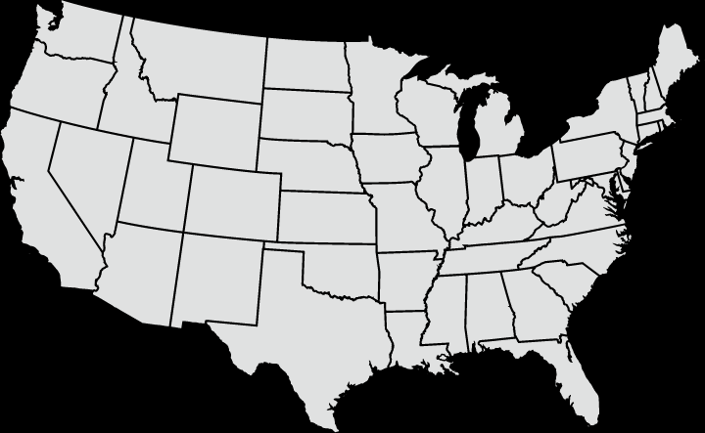
CCA Today
Commonwealth Care Alliance® (CCA) is a mission-driven healthcare services organization that offers innovative health plans and care delivery programs designed for individuals with the most significant needs.
With offerings in Massachusetts, Rhode Island, Michigan, and California, CCA delivers comprehensive, integrated, and person-centered care by coordinating the services of local staff, provider partners, and community organizations.
The CCA uncommon care® model is consistently recognized for finding and engaging traditionally hard-to-reach individuals.
CCA was named a Best Place to Work for Disability Inclusion on the 2023 Disability Equality Index® and a Top Place to Work for 2022 by The Boston Globe.
Commonwealth Care Alliance Massachusetts
2 Medicare Advantage Plans
1 Medicaid-Medicare Plan (MMP)
1 Dual Special Needs Plan
CCA Health Michigan
CCA PO
CCA ACO
1 Medicare Advantage Plan
1 Dual Eligible Special Needs Plan
CCA Health Rhode Island
2 Medicare Advantage Plans
1 Dual Eligible Special Needs Plan
CCA Health California
1 Medicare Advantage Plan
Active CCA Markets

Slide 27
Member Demographics
CCA One Care
CCA Senior Care Options
52 | average age
59.8% | have a major physical and/or behavioral health disability
6.5% | have a major physical disability, such as paralysis, spinal cord injury, multiple sclerosis, muscular dystrophy, cerebral palsy, or ventilator dependency
37.8% | have a substance use disorder (excluding tobacco and nicotine)
55.7% | have severe mental illness, such as schizophrenia, bipolar disorder, or severe depression (excluding substance-use disorders)
75 | average age
46.1% | have four or more chronic conditions
24.1% | have a physical and/or behavioral health disability
6.4% | have a major physical disability, such as paralysis, spinal cord injury, multiple sclerosis, muscular dystrophy, cerebral palsy, or ventilator dependency
54.3% | have diabetes
63.7% | primarily speak a language other than English

Slide 28
Key Program Principles to Advance Integrated Care: An Integrated Health Plan Perspective
One accountable entity to provide the full range of Medicare and Medicaid services
Targeted programs designed specifically to meet dually eligible populations' needs
Program flexibilities which promote person-centered care, address health-related social needs, and allow for meaningful beneficiary, family and caregiver input
Enrollment strategies that balance individual choice and encourage integrated options
Appropriate payment, risk adjustment and quality measurement policies which reflect the clinical profiles, demographics and diversity
Strong partnerships among CMS, states and health plans to ensure optimal oversight and program effectiveness
Integrated financing to align incentives and reduce cost-shifting

Slide 29
What Fundamentals Do States Need to Advance Integration?
Key resources
Medicare expertise
Technical assistance with operations and contracting
Data
State infrastructure
Programs designed to meet the specific population needs
Coordination across state agencies
Commitment to engaging stakeholders and building stakeholder support
Outreach and education to support integrated care enrollment

Slide 30
Contact Information
Michelle Herman Soper
Vice President, Federal Policy & Advocacy
msoper@commonwealthcare.org
commonwealthcarealliance.org

Slide 31
Kate Massey, MPA
Executive Director
Medicaid and CHIP Payment and Access Commission

Slide 32
MACPAC: Policy Approaches for Improving Care for Dually Eligible Beneficiaries
Kate Massey
Notes:
Presentation Title: Title Case, Arial Bold, 40pt, dark blue (can be smaller for long titles)
Subtitle: Sentence Case, Arial, 20pt, black – may need to manually adjust position up or down depending on how many lines of text the Presentation Title is
Author’s Name: Arial, 20pt, black – divider line position should be above the Authors and can be manually adjusted if needed.
Handouts provided in 508 compliant format for a PowerPoint presentation must be printed in outline view.
Select File Tab > Save and Send > Create Handouts
There are several options to choose from―selecting “Outline Only” saves just the text from the slides.

Slide 33
Data on Dually Eligible Beneficiaries, CY 2021
12.8 million people dually eligible for Medicare and Medicaid
64 percent were age 65 or older
73 percent were eligible for full Medicaid benefits (full-benefit duals)
Combined Medicare and Medicaid spending of $493.4 billion
63 percent or $312.0 billion in Medicare
37 percent or $181.5 billion in Medicaid
Account for a disproportionate share of Medicare and Medicaid spending relative to enrollment
19 percent of Medicare enrollment, 35 percent of Medicare spending
13 percent of Medicaid enrollment, 27 percent of Medicare spending
Full-benefit dually eligible beneficiaries in fee for service (FFS) were more likely to use institutional long-term services and supports than non-dual Medicaid beneficiaries (15 percent vs. 4 percent)
Notes:
Slide Title: Title Case, Arial Bold, 30pt, dark blue
Paragraph Text: Arial, 20pt, black
Bullet Level 1 Text: Arial, 20pt, black
Bullet Level 2 Text: Arial, 16pt, black

Slide 34
Demographic Characteristics: Comparing Dual and Non-Dual Beneficiaries, CY 2021
Note: CY is calendar year. Exhibit includes all dually eligible beneficiaries and non-dual eligible Medicare beneficiaries including people covered in fee-for-service, managed care, and people with end-stage renal disease.
Source: MACPAC, MedPAC, 2024, Data Book: Beneficiaries Dually Eligible for Medicare and Medicaid, January 2024.
Notes:
DELETE?? From Gabby’s January 2024 Duals Data Book Highlights presentation

Slide 35
Policy Approaches for Improving Care for Dually Eligible Beneficiaries
Increase state Medicare expertise
Develop a strategy to address coverage for the dually eligible population with state leadership buy-in
Use existing tools
Leverage state Medicaid agency contracts (SMACs) with D-SNPs
Anticipate varied landscape
Increasing enrollment in Medicare Advantage and in Medicaid managed care
State priorities and conditions on the ground
Limited resources
Alternatives for FFS states
Notes:
Slide Title: Title Case, Arial Bold, 30pt, dark blue
Paragraph Text: Arial, 20pt, black
Bullet Level 1 Text: Arial, 20pt, black
Bullet Level 2 Text: Arial, 16pt, black

Slide 36
Relevant MACPAC Recommendations
June 2020 Report to Congress
Provide additional federal funds to enhance state capacity to develop expertise in Medicare and to implement integrated care models
June 2023 Report to Congress
Require all states to develop a strategy to integrate Medicaid and Medicare coverage for full-benefit dually eligible beneficiaries
Strategy should include the following components - integration approach, eligibility and benefits covered, enrollment strategy, beneficiary protections, data analytics, quality measurement - and be structured to promote health equity
Provide additional federal funding to states to assist with these efforts toward integrating Medicaid and Medicare coverage for full-benefit dually eligible beneficiaries
Notes:
Kate, I’m thinking you don’t need rec 2.1. It’s too in the weeds. Thoughts?
June 2020 Report to Congress
Recommendation 2.1: The Centers for Medicare & Medicaid Services should issue subregulatory guidance to create an exception to the special enrollment period for dually eligible beneficiaries eligible for Medicare-Medicaid Plans. This exception would allow such individuals to enroll on a continuous (monthly) basis. For purposes of switching plans or disenrolling under the special enrollment period, Medicare-Medicaid Plan enrollees should be treated the same as other dually eligible beneficiaries in Medicare Advantage.
Recommendation 2.2: Congress should provide additional federal funds to enhance state capacity to develop expertise in Medicare and to implement integrated care models.
June 2023 Report to Congress
Recommendation 5.1: Congress should authorize the Secretary of the U.S. Department of Health and Human Services to require that all states develop a strategy to integrate Medicaid and Medicare coverage for full-benefit dually eligible beneficiaries within two years with a plan to review and update the strategy, to be specified by the Secretary. The strategy should include the following components—integration approach, eligibility and benefits covered, enrollment strategy, beneficiary protections, data analytics, quality measurement—and be structured to promote health equity. To support states in developing the strategy, Congress should provide additional federal funding to states to assist with these efforts toward integrating Medicaid and Medicare coverage for full-benefit dually eligible beneficiaries.

Slide 37
Relevant MACPAC Recommendations, cont.
Under consideration for June 2024 Report to Congress
States should use their authority at 42 CFR 422.107 to require that D-SNPs operating in their state regularly submit data on care coordination and Medicare Advantage encounters to the state for purposes of monitoring, oversight, and assurance that plans are coordinating care according to state requirements
If Congress requires that all states develop a strategy to integrate care, states that include D-SNPs in their integration approach should describe how they will incorporate care coordination and utilization data and how these elements can advance state goals
Federal government should issue guidance that supports states in developing a strategy tailored to each state’s health coverage landscape that also emphasizes how states can use their SMACs to advance state policy goals

Slide 38
MACPAC: Policy Approaches for Improving Care for Dually Eligible Beneficiaries
Kate Massey
Notes:
Handouts provided in 508 compliant format for a PowerPoint presentation must be printed in outline view.
Select File Tab > Save and Send > Create Handouts
There are several options to choose from―selecting “Outline Only” saves just the text from the slides.

Slide 39
Moderated Q & A

Slide 40
TAKE OUR SURVEY
Please fill out the evaluation survey by using the link in the chat or via email this afternoon!
Title
Details
www.allhealthpolicy.org
Notes:
Medicare Series

Slide 41
UPCOMING EVENTS
Title
Details
Health Care Costs
Spring 2024
2024 Signature Series Summit:
AI in Health – Navigating New Frontiers
July 25, 2024
allh.us/events
Notes:
Medicare Series

Slide 42
THANK YOU FOR ATTENDING!

