Slide 1


2024 Voter Priorities in
Health Care: Telling the Policy Story
Wednesday, May 15, 2024

Slide 2



Alison Jones, MPH
Director of Program Strategy and Management
Alliance for Health Policy

Slide 3


PARTNERS

Slide 4
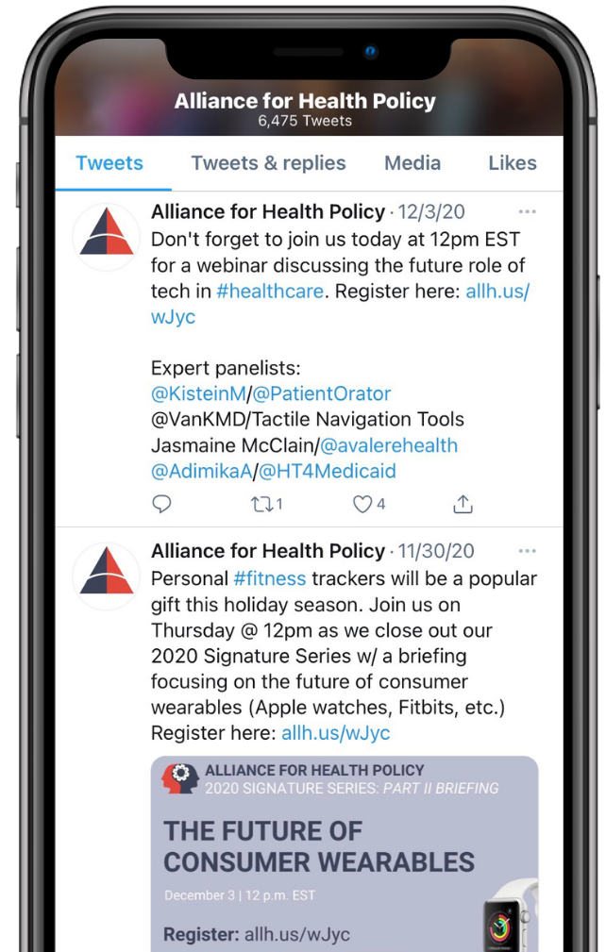


JOIN THE CONVERSATION
@AllHealthPolicy
Alliance for Health Policy
Alliance for Health Policy
@AllianceforHealthPolicy
@AllianceforHealthPolicy
Notes:
Medicare Series

Slide 5
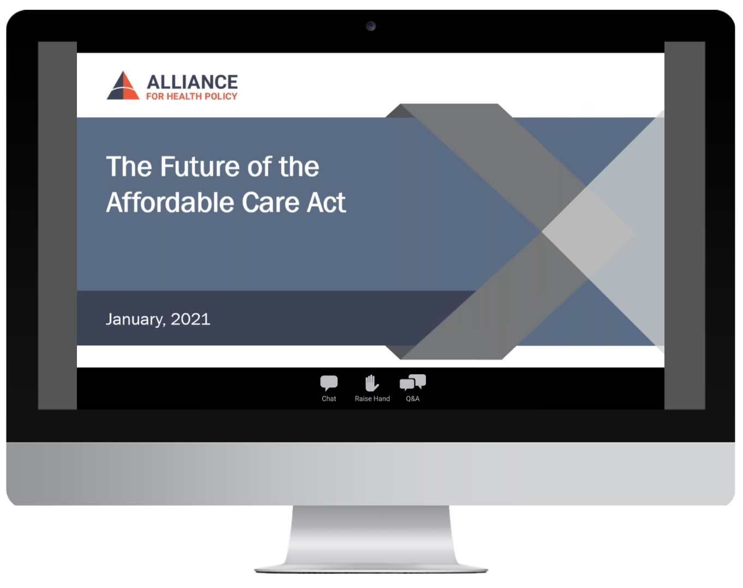
PARTICIPATING
To ask a question click the Q&A button and enter your text in the chat box.

Slide 6

MODERATOR
Claire Sheahan, M.Sc.
President and CEO
Alliance for Health Policy

Slide 7

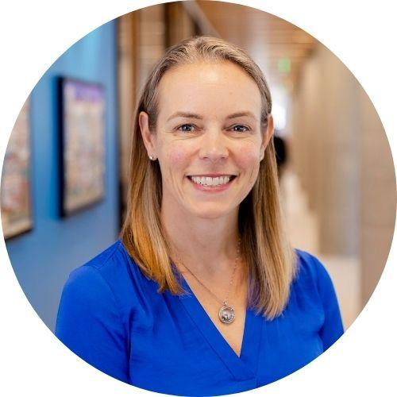
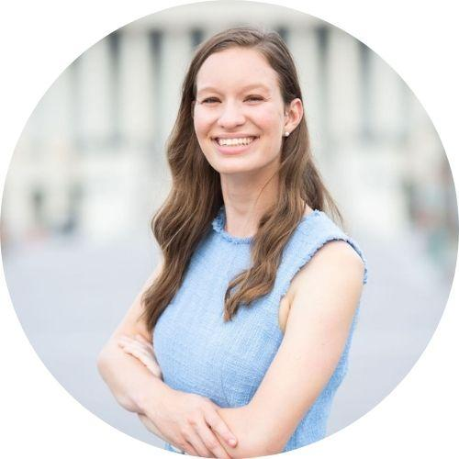
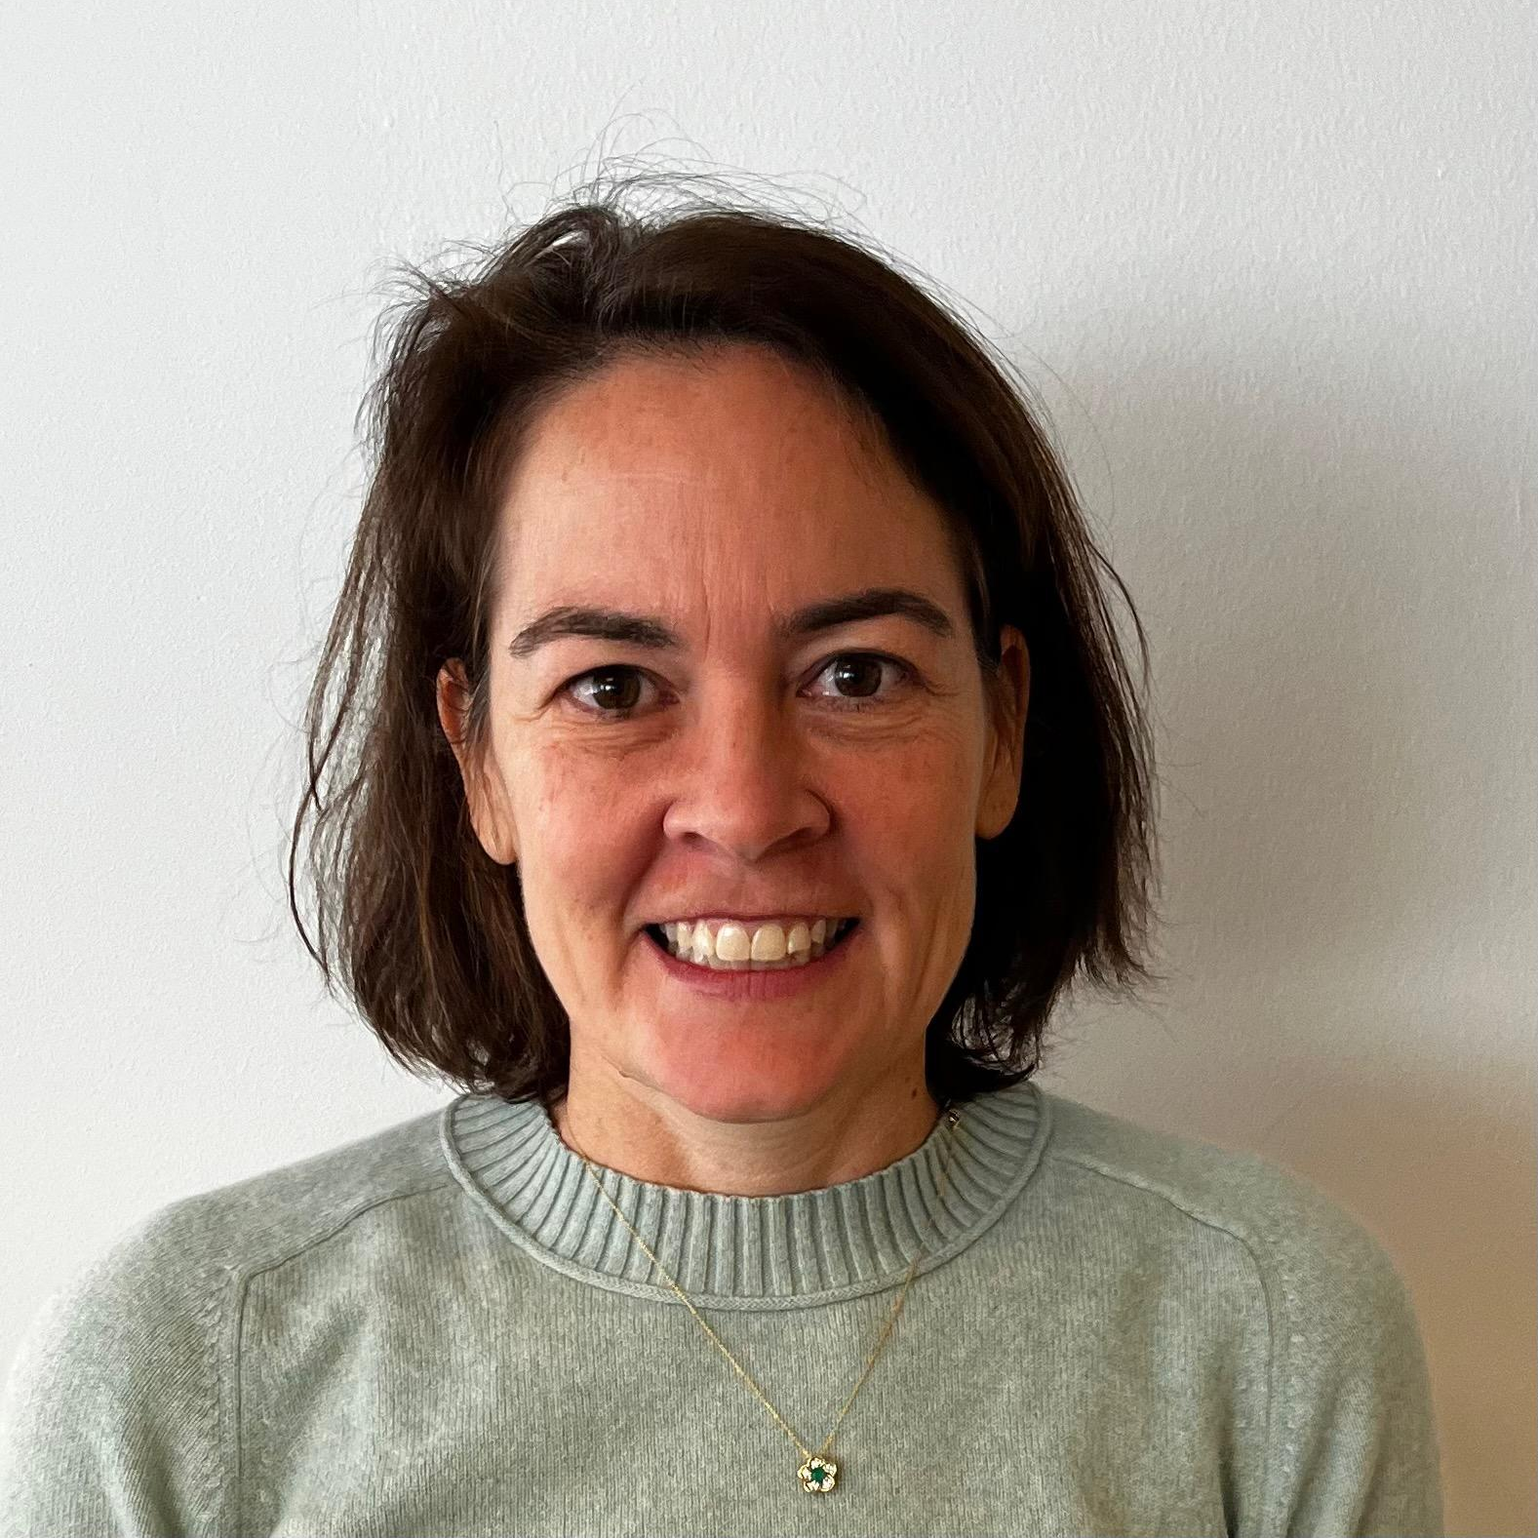
PANELISTS
Liz Hamel
Vice President and Director, Public Opinion and Survey Research
KFF
Rachel Cohrs Zhang
Chief Washington Correspondent
STAT
Annie Linskey
Reporter
The Wall Street Journal

Slide 8

Moderated Discussion

Slide 9
Health Care Issues in the 2024 Presidential Election
This is not a “health care election”
  Issues are only one factor among many that voters consider (others are partisanship, candidate characteristics, personal considerations)
  Among issues, voters are more focused on inflation, immigration, democracy, and the economy than health care
But discussion of health issues could play a big role in the campaign
  The cost of health care is a big part of voters’ concerns about inflation and the economy, and they want to hear signals from candidates that they are committed to lowering these costs for people
  Many existing health programs (Medicare, Medicaid, and increasingly the ACA) are popular, voters may react to messaging implying cuts or changes to these programs
  Issues like abortion may not top the list, but could motivate turnout for specific groups that could be decisive in key states

Slide 10
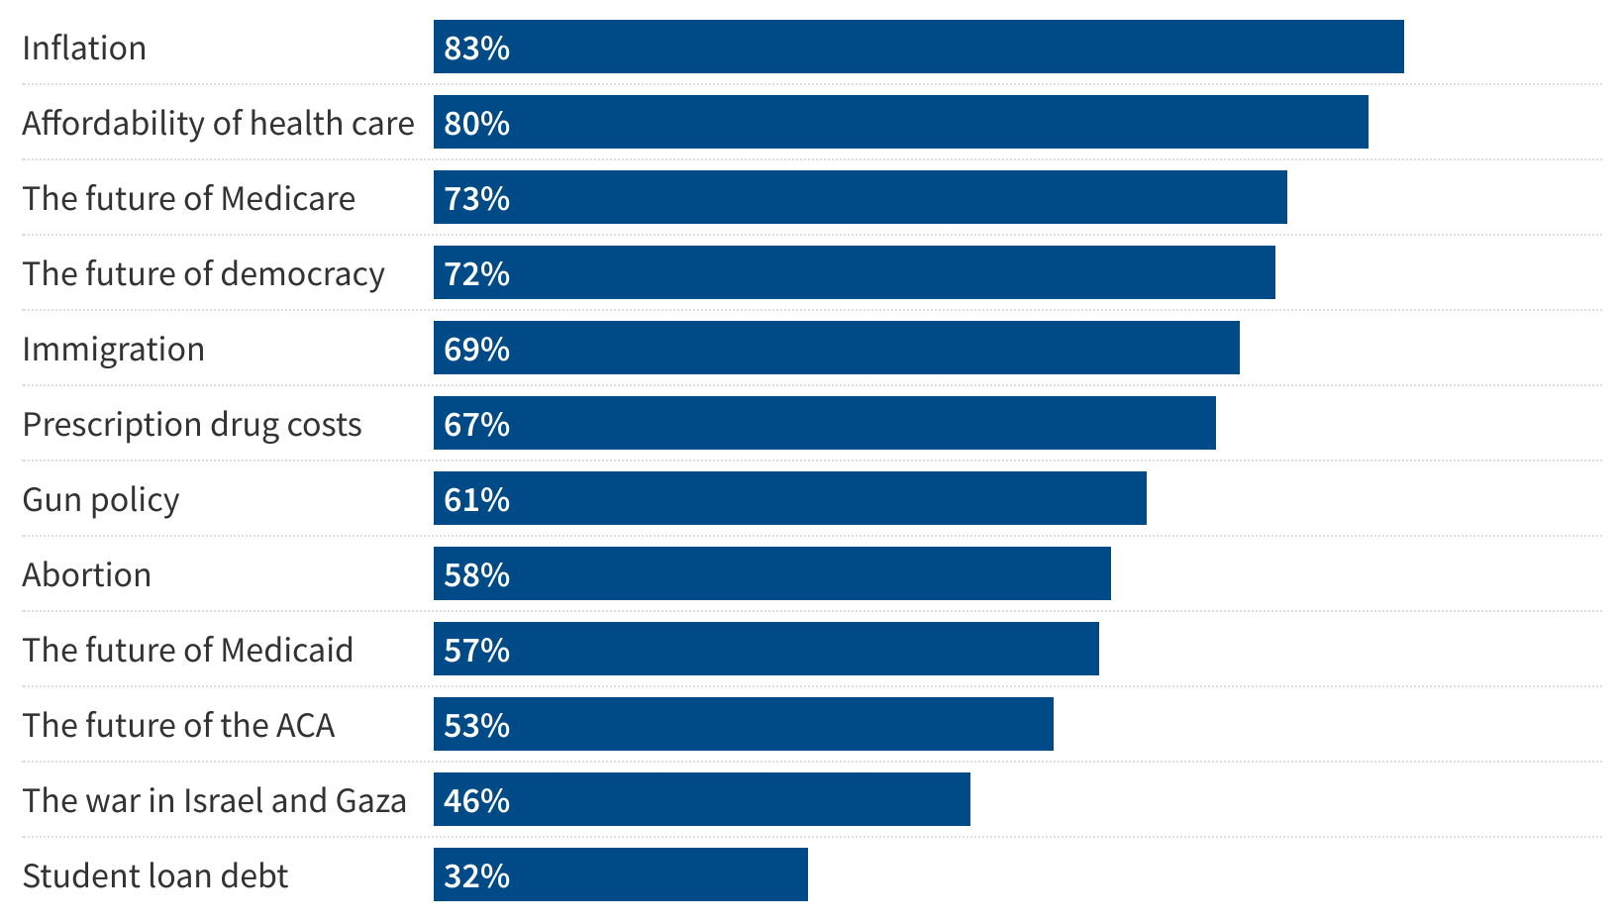
What Do Voters Want to Hear Candidates Talk About?
Percent of registered voters who say it is very important for 2024 presidential candidates to talk about each of the following:
NOTE: Among registered voters. See topline for full question wording.
SOURCE: KFF Health Tracking Poll (Jan. 30-Feb. 7, 2024)
Notes:
Notes: Varies by party… Want to hear about HC affordability… similar across parties (unexpected med bills worry finding here)
… but this doesn’t mean they want to hear detailed plans

Slide 11
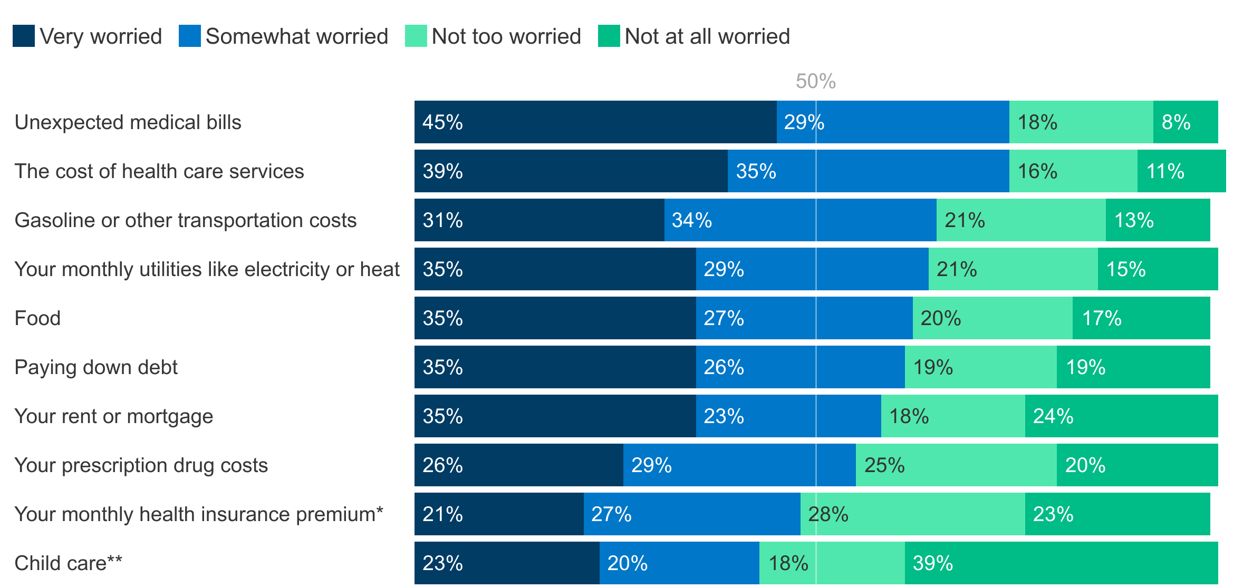
Health Care Costs Are Major Factors In Economic Concerns
How worried, if at all, are you about being able to afford each of the following for you and your family?
NOTE: *Asked of insured adults. **Among parents or guardians of a child under age 18 living in their household. See topline for full question wording.
SOURCE: KFF Health Tracking Poll (Jan. 30-Feb. 7, 2024)

Slide 12
What About the ACA?
On the one hand…
  More popular and less polarized now than when it passed (60% favorable)
  Many provisions are extremely popular (pre-existing conditions)
On the other…
  Most don’t think the ACA lowered health care costs for people like them
  Views of the law overall are still sharply divided along partisan lines
Bottom line: Voters (particularly Democrats) may want to hear candidates talk about the ACA, but they are not looking for detailed policy proposals

Slide 13
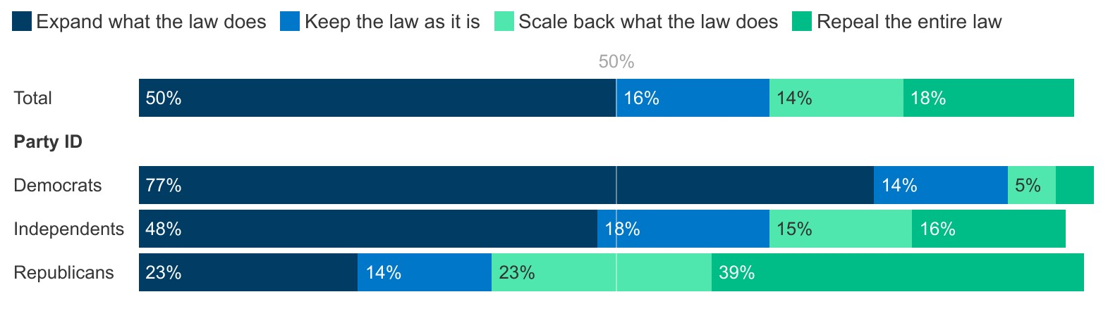
Larger Shares Of The Public Want To See The ACA Expanded Than Repealed Or Scaled Back
What would you like to see the next president and Congress do when it comes to the Affordable Care Act?
NOTE: See topline for full question wording.
SOURCE: KFF Health Tracking Poll (Jan. 30-Feb. 7, 2024)

Slide 14
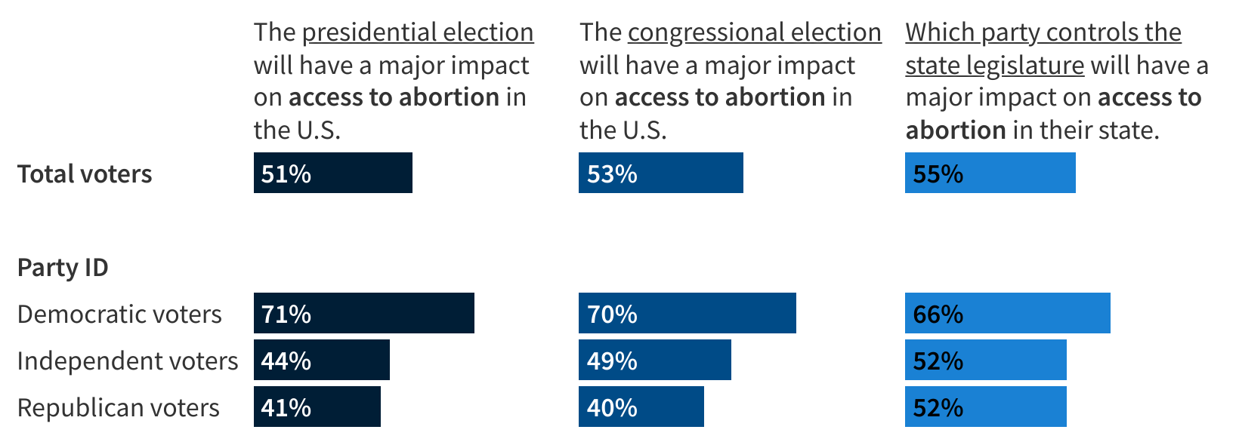
Voters (Particularly Democrats) Believe This Election Has Stakes for Abortion Access
Percent of registered voters who say:
Note: Among registered voters. See topline for full question wording.
Source: KFF Health Tracking Poll (February 20-28, 2024)

Slide 15
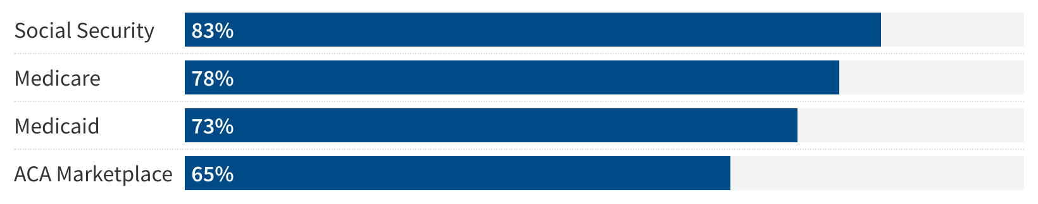
Majorities Of Voters Worry About Future Benefits Under Entitlement Programs
Percent of registered voters who say they are very or somewhat worried that in the future, people covered by each of the following will not be able to get the same level of benefits that are available to people covered today:
Note: Among registered voters. See topline for full question wording.
Source: KFF Health Tracking Poll (April 23-May 1, 2024)

Slide 16
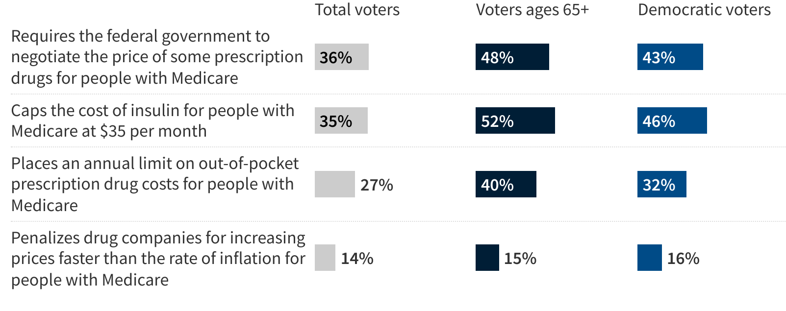
Few Voters Are Aware Of IRA Drug Pricing Provisions, But Awareness Is Higher Among Older Voters And Democrats
Percent of registered voters who know there is a federal law in place that does each of the following:
Note: Among registered voters. See topline for full question wording.
Source: KFF Health Tracking Poll (April 23-May 1, 2024)

Slide 17
A Few Tips for Interpreting Election Polls About Health Policy
So, look for findings that go beyond the horserace, but understand that policy preferences as measured by polls are not predictive of election outcomes
Pay attention to what polls can tell you about key subgroups of voters and how issues may motivate turnout in addition to vote choice
Polls can also help you understand people’s experiences and gaps in voters’ knowledge, which can be a story in itself, or can help identify areas where your stories can help inform
Survey nerd plug: read the methodology!
Notes:
“Game of inches”

Slide 18
Moderated Q & A

Slide 19

TAKE OUR SURVEY
Please fill out the evaluation survey by using the link in the chat or via email this afternoon!
Title
Details
www.allhealthpolicy.org
Notes:
Medicare Series

Slide 20
UPCOMING EVENTS
Title
Details
2024 Signature Series Summit:
AI in Health – Navigating New Frontiers
Barbara Jordan Conference Center
July 25, 2024
Ask the Experts: Understanding Polling and Health Priorities in the 2024 Election
May 29, 2024
allh.us/events
Notes:
Medicare Series

Slide 21
THANK YOU FOR ATTENDING!

